Slide 1

New AQA Spec
A Level Psychology
Introduction Summer Project 2018
This research based project is designed to give you an ideal grounding for your A Level Psychology course.
Research and complete the tasks independently over the summer in preparation for Year one of the Psychology A-Level.
Present the tasks in any format you like and bring it with you to your first lesson after the summer.
Good luck and Enjoy ☺
Mrs Jackson (Leader of Psychology)

Slide 2
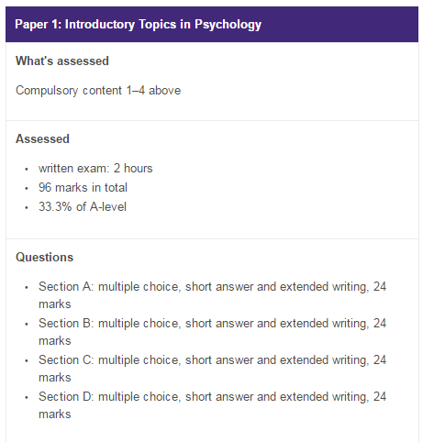
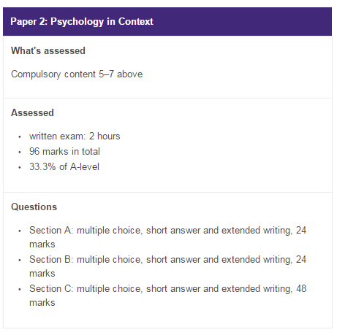
The AQA Course
A-Level
Topics:
Memory
Social Influence
Attachment
Psychopathology
Topics:
Approaches in Psychology
Biopsychology
Research Methods

Slide 3
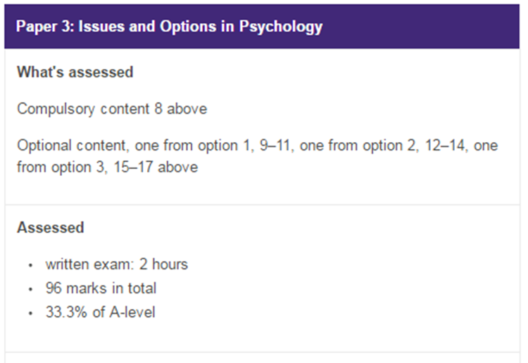
The AQA Course
A-Level
Topics:
Issues and debates
Relationships
Eating behaviours
Forensics
100% Exam based 0% Course work

Slide 4

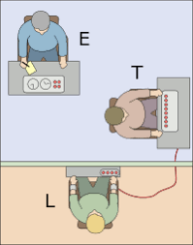
Key studies in Psychology
Topic of Social Influence
Task 1: Outline Zimbardo’s Stanford Prison Experiment in terms of the following:
Aim
Design
Sample
Procedure
Results
Conclusion
Topic of Social Influence
Task 2: Outline Milgram’s Obedience to Authority Experiment in terms of the following:
Aim
Design
Sample
Procedure
Results
Conclusion

Slide 5
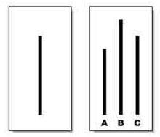

Key studies in Psychology
Topic of Social Influence
Task 3: Outline Asch’s Conformity Experiment in terms of the following:
Aim
Design
Sample
Procedure
Results
Conclusion
Topic of Approaches
Task 4: Outline Pavlov’s study on Classical conditioning in terms of the following:
Aim
Design
Sample
Procedure
Results
Conclusion

Slide 6
Useful Resources & Further Reading
To help you on your way…
Websites:
http://www.simplypsychology.org/a-level-psychology.html - Tailored to the old specification, but has all the relevant key information for A Level Psychology.
http://www.aqa.org.uk/subjects/psychology/as-and-a-level/psychology-7181-7182 This is the course specification, have a look at what you will be studying in a bit more detail by clicking the link.
Optional Reading (Books):
Working Memory, Thought and Action – Alan Baddeley
The Lucifer Effect – Phillip Zimbardo
Obedience to Authority – Stanley Milgram
Fundamentals of Cognition – Michael Eysenck
Psychology: The Science of the Mind and Behaviour – Richard Gross
The Complete Companions: AQA Psychology Year 1 and AS Student Book – Mike Cardwell & Cara Flanagan
AQA Psychology for A Level Year 1 and AS Student Book – Cara Flanagan & Dave Berry

