Slide 1
A Level Media Studies

Slide 2
Taster lesson outcomes
Give you an insight into what studying A Level media will be like at LHS
Use your understanding of ‘representation’ to analyse how different media products communicate meanings to an audience

Slide 3
Media Studies
You study a broad range of media forms:
Advertising (print and audio visual), music videos, newspapers, film, radio, videogames, (yr12)
television, magazines and media in the online age (yr13)

Slide 4
Exams and coursework??
Component 1: Media Products, Industries and Audiences
Written examination: 2 hours and 15 minutes
35% of qualification
Component 2: Media Forms and Products in Depth
Written examination: 2 hours and 30 minutes
35% of qualification
Component 3: Cross media production
Non-exam assessment
30% of qualification

Slide 5
Media studies: Theoretical framework
Media language
- how the media through their forms, codes, conventions and techniques communicate meanings
Representation
-how the media portray events, issues, individuals and social groups
Media industries
-how the media industries’ processes of production, distribution and circulation affect media forms and platforms
Audiences
-how media forms target, reach and address audiences, how audiences interpret and respond to them, and how members of audiences become producers themselves

Slide 6
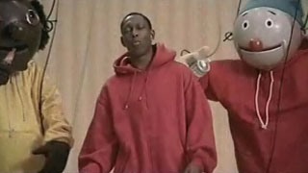
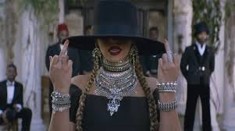
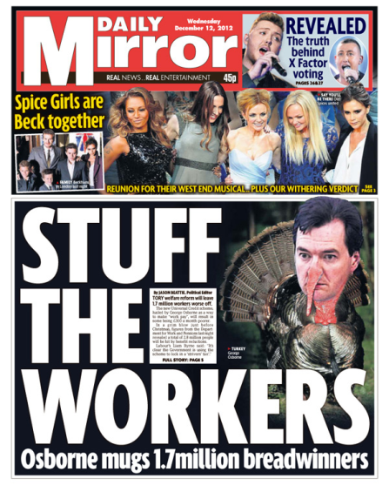
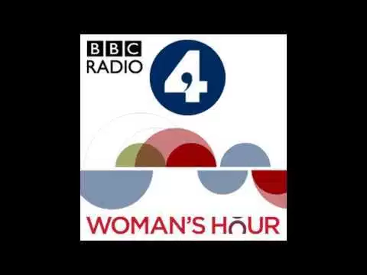
Set texts- Year 12
Examination 70%
Music video
Advertising and marketing
Newspapers
Film
Radio
Video games

Slide 7
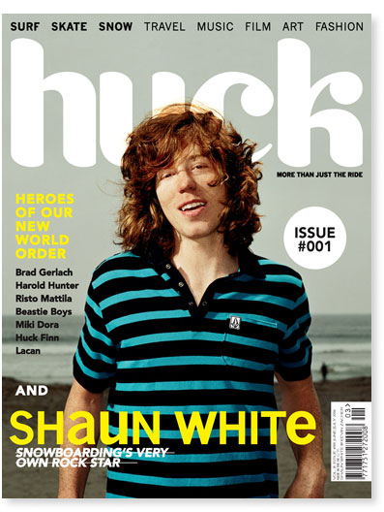
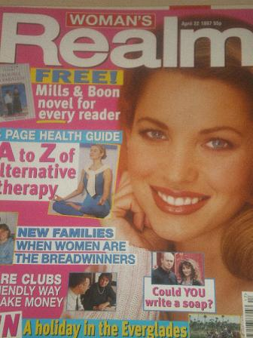
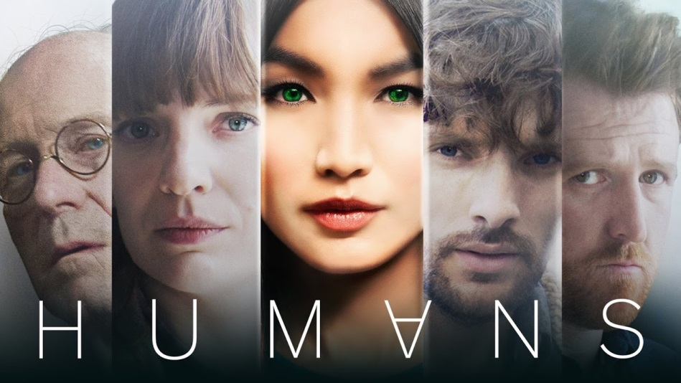
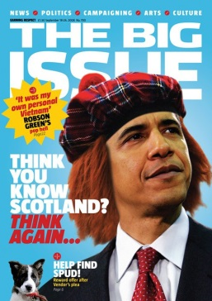
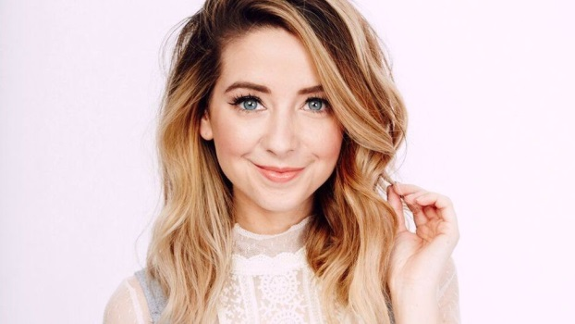
Set texts - Year 13
Television
Magazines
Blogs and websites

Slide 8
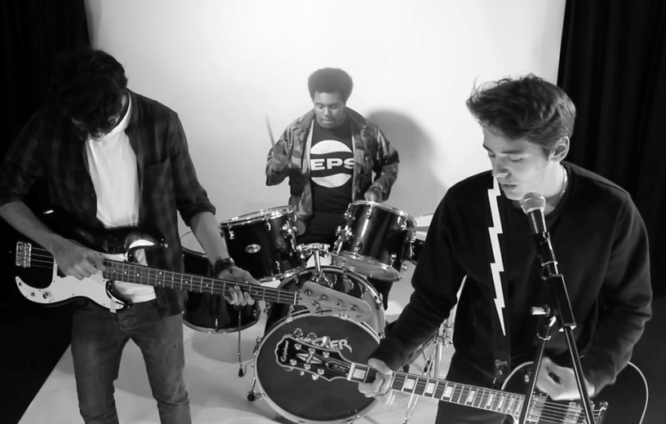
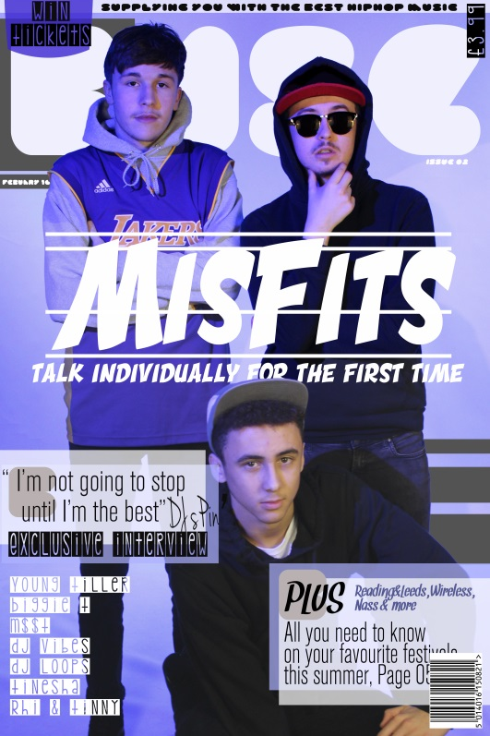
Non- exam assessment (coursework) 30%
Create either a music video and related online products (such as website)
Or a magazine
for a specific audience as set by the exam board

Slide 9
A ‘taste’ of year 12…
Such as…Brexit, Elections,
Representation
-how the media portray events, issues, individuals
and social groups
Such as Donald Trump, Theresa May,
Such as…old age, young people, women, men, homosexuality, black/ white people,

Slide 10
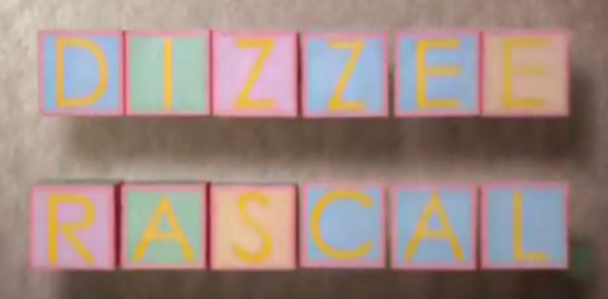
Music video: Dizzee Rascal -Dream
How are gender, age and ethnicity represented in this music video?
https://www.youtube.com/watch?v=3voUHjPkNao

Slide 11
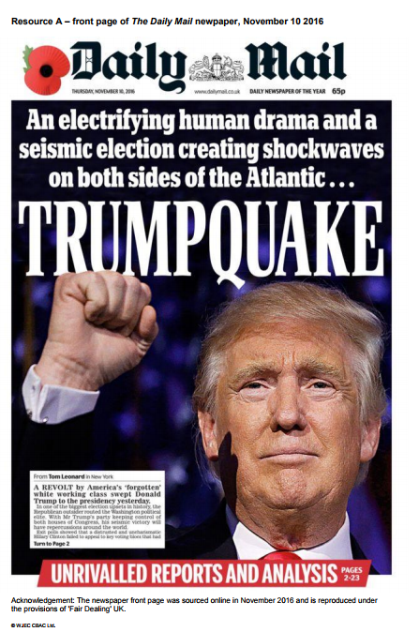
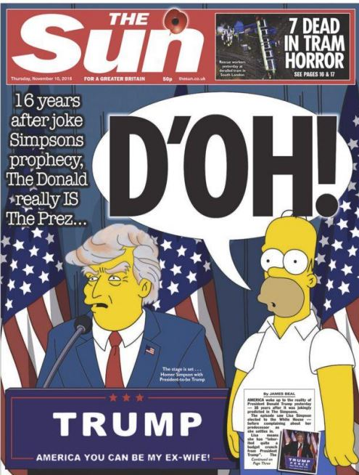
Newspapers: How do these front covers use language, image, colour, font to construct a representation of Donald Trump?

Slide 12
Film- trailer

Slide 13
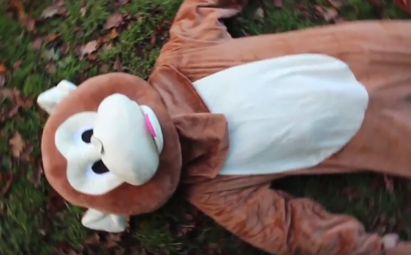
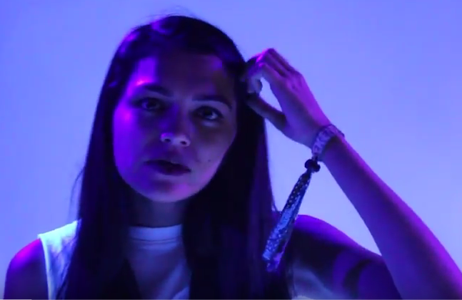
Finally…any questions?
https://www.youtube.com/watch?v=G0VyiVAKWSY&list=PLUtYDozH5mN1KKO7b0KgTzJNc0-bGrHBL&index=4
https://www.youtube.com/watch?v=tjepDtWeBRQ&list=PLUtYDozH5mN1KKO7b0KgTzJNc0-bGrHBL&index=6
Examples of our music videos!

