Slide 1
Level 3 Certificate/Diploma in
Food Science and Nutrition
The Level 3 Food Science Diploma
(2 year course) has the same value as a
A-Level and is recognised by all universities

Slide 2
Level 3 Food Science and Nutrition taster lesson
Ento-moph-agy

Slide 3
Level 3 Certificate in
Food Science and Nutrition
Year 12
Unit | Title | Assessment
1 | Meeting the needs of specific groups | Internal and external

Slide 4
Level 3 Diploma in
Food Science and Nutrition
Year 13
Unit | Title | Assessment
1 | Meeting the needs of specific groups | Internal and external completed in Year 12
2 | Ensuring food is safe to eat | External
3 | Experimenting to solve food production problems (optional) | Internal
4 | Current issues in food science and nutrition (optional | Internal

Slide 5
Reasons to study …..
Level 3 Food Science and Nutrition qualiﬁcations allow students to gain a knowledge about the food and nutrition industry.
Students will have the opportunity to learn about
the relationship between the human body and food
practical skills for cooking and preparing food.
Students will be able to consider employment in a range of diﬀerent industries including the food and drink sectors of hospitality, catering, food production and food retail

Slide 6
Plan, Do, Review
Level 3 Food Science has been designed around the concept of a ‘plan, do, review’ approach to learning.
There is a strong emphasis on practical work, making this an ideal choice for students who prefer to learn by doing.

Slide 7
Questions to think about in Unit 1
Why do we need to follow food hygiene regulations?
What is cross contamination?
How do you know something is cooked and safe to eat?
What are nutrients?
Why do we need them? Is any food “bad” for us? Could fizzy drinks replace water?
How does loss of mobility affect what I need to eat?
Should we eat more in the winter?
Can vitamin tablets replace fresh fruit? How can you make sure that when you cook a meal, everything is ready on time?
How can you a make a dish look attractive?

Slide 8
What you would cover in Y12
Theory
Understand the importance of food safety
Understand properties of nutrients
Understand the relationship between nutrients and the human body
Be able to plan nutritional requirements
Practical Skills
Be able to plan production of complex dishes
Be able to cook complex dishes

Slide 9
Delivery of unit 1
Presentations
Case study's
Posters/ booklets
Practical activities
Visits to workplaces such as a day centres for adults and investigating how menus meet nutrition and food safety requirements
Talks by an Environmental Health Officer
Carrying out a work based activity such as cooking nutritious meals for a group of adults preparing for a sporting event
Arranging visits to workplaces such as a hospital kitchen to observe how large scale food production is planned and implemented
•Talks by visiting speakers

Slide 10
Exams
The Level 3 Food Science certificate
(2 year course) has the same value as a A-Level and is recognised by all universities
In the June in Year 13
90 mins
3 sections
Short answers
Extended answers
Case study questions
Worth 50%

Slide 11
Level 3 Food Science and Nutrition taster lesson
Ento-moph-agy

Slide 12
What do you think entomophagy mean???

Slide 13
Video
Entomophagy: Food of the future
Questions…..
1
2
3

Slide 14
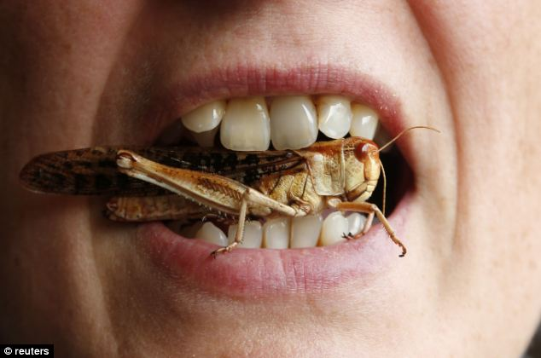
How do you feel about eating insects?
Will you take the Bush Tucker Trial?

Slide 15
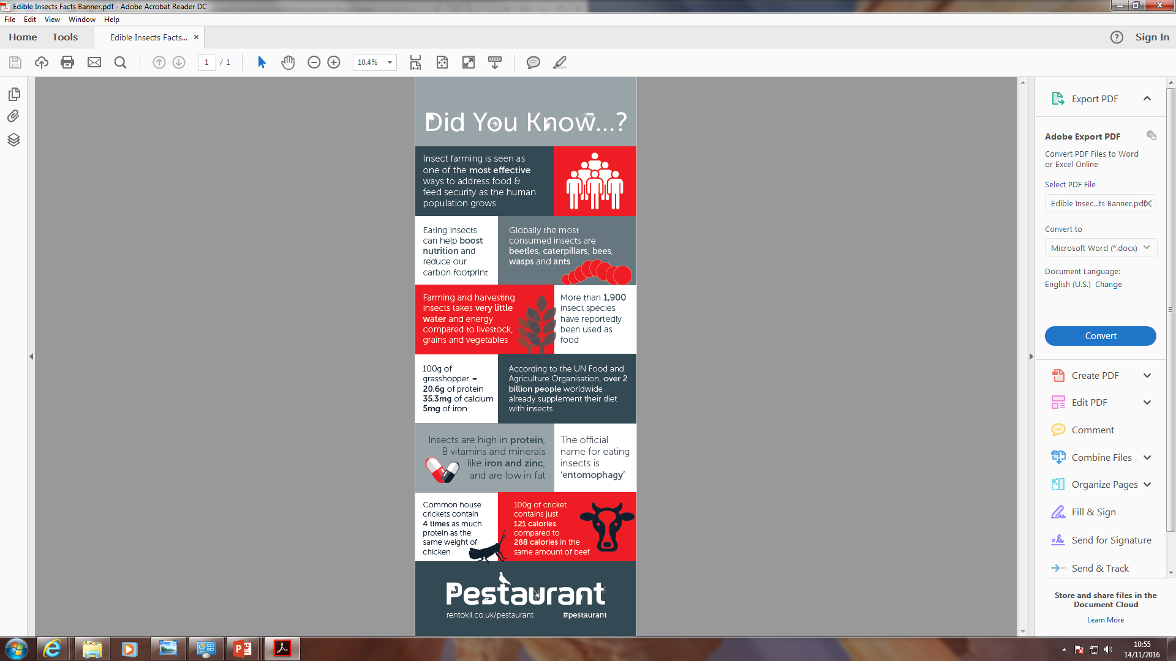
How does eating bugs link to protein?

Slide 16
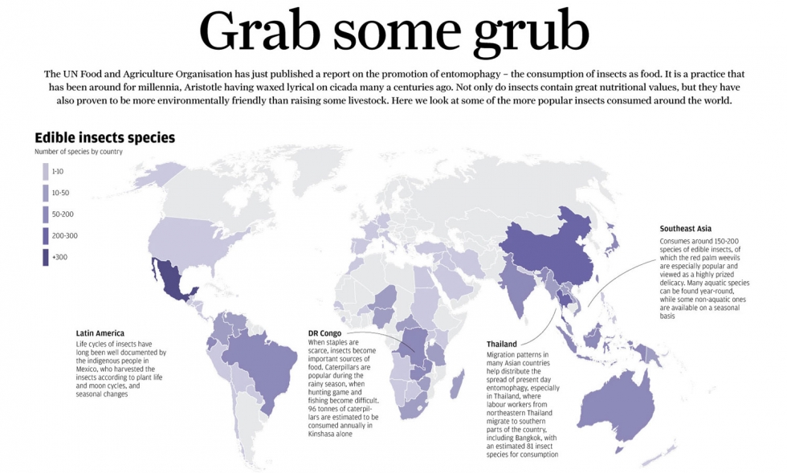

Slide 17

Are all insects edible?
No
You should avoid….
brightly coloured
hairy or prickly insects
This is because…..
they may be poisonous.
‘Red, orange or yellow forget this fellow. Black, green or brown wolf it down’.

Slide 18
What do insects taste like?
slightly nutty
chewy
earthy
tasteless but ….
it’s more likely a pre-conceived notion that tricks our taste buds into thinking they taste bad.

Slide 19
Which insect is eaten the most?
Beetles
crickets
Mealworms/silk worms
Why….
they’re inexpensive,
easy to breed
simple to prepare and cook..

Slide 20
Insects are very nutritious,
high in protein
low in carbohydrates
Good sources of trace minerals – iron
The main components of insects are protein, fat and fibre
Are insects nutritious?

Slide 21

Insects vs meat….
Insects are more nutritious than
chicken,
pork,
beef
fish.

Slide 22
The taste test……
Questions to think about?
How hard was it to take the first bite?
Why do you think that some people would struggle to eat insects?
How could you use insects in a meal?
What surprised you about the taste test?
How does this compare to eating a more regular protein food?

Slide 23
The taste test……
Questions to think about?
How hard was it to take the first bite?
Why do you think that some people would struggle to eat insects?
How could you use insects in a meal?
What surprised you about the taste test?
How does this compare to eating a more regular protein food?

Slide 24
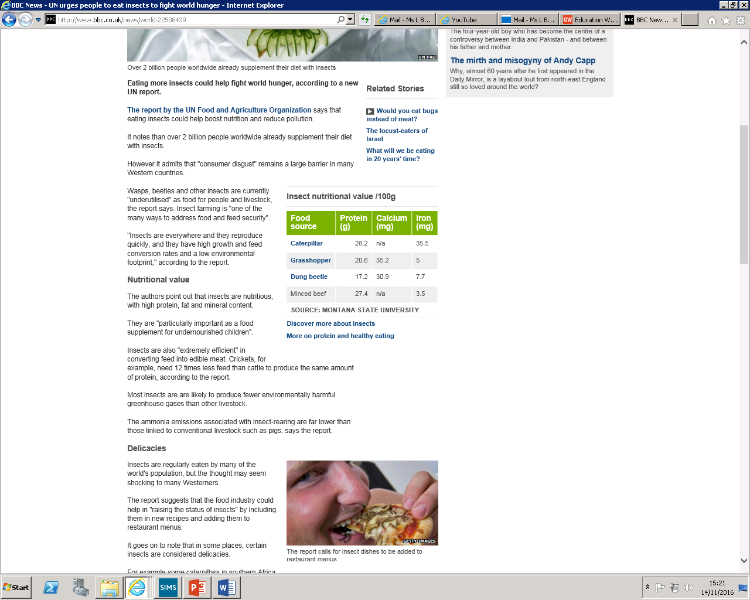
Plenary
Why should you suggest to people to eat insects instead of regular meat?

