Slide 1
CAROLINE SIDELL

Slide 2
SESSION OUTCOMES
The importance of your health and wellbeing to get through exams
Understand & apply the 4 pillars of wellness
Top tips & strategies to cope with the emotional & physical highs and lows during stressful times

Slide 3
In your role as a student, it is important that you are both physically and emotionally healthy
You can't perform in or out of school if you don't feel well

Slide 4
Being healthy means that your body and mind function as they are supposed to
You can maintain your health by taking care of yourself in many different ways

Slide 5
Importance of health & wellbeing at school
Being healthy makes you feel good and allows you to perform more effectively.
Improve fitness & strength
More resilient
Increased confidence
Boosts energy levels
Reduces stress levels
Reduces anxiety
Improved sleep
Feel healthier

Slide 6
FOUR PILLARS OF WELLNESS
1. Physical Activity
2. Proper diet & nutrition
3. Sleep, rest & recovery
3. Mindset & managing stress

Slide 7
1. Physical Health

Slide 8
HOW MANY HOURS OF PHYSICAL ACTIVITY DO YOU COMPLETE IN A WEEK?
What is stopping you?
Regular Physical Activity impacts the brain, it…
Boosts your memory
Improves your concentration
Helps reduce stress
Lengthens attention span

Slide 9
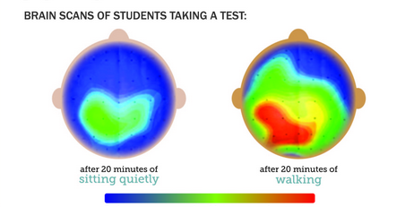
Physically active students have more active brains
Red areas are very active; Blue areas are least active

Slide 10
2. Nutrition

Slide 11
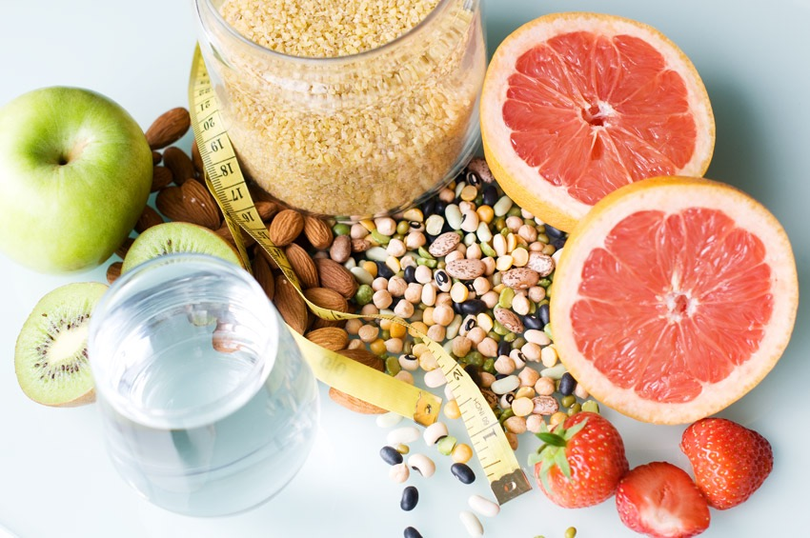
NUTRITION & STRESS
Someone with a healthy balanced diet is less likely to be stressed

Slide 12
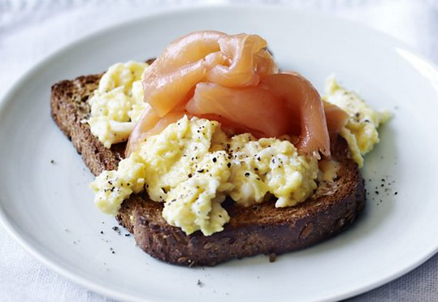
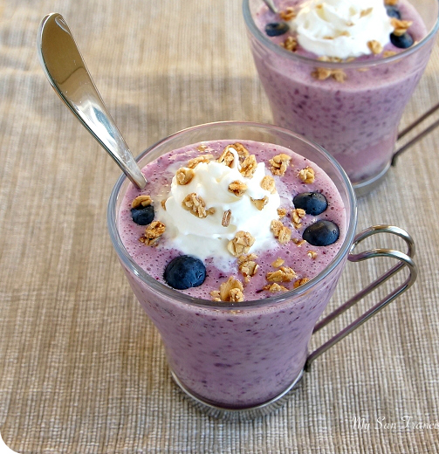
Eating a nutritious breakfast can help you perform better in exams and during the day
“
Eating the right food and drink can energise your system, improve your alertness and sustain you through the long exam hours
”

Slide 13
One of the best ways to maximise your focus is to stay hydrated
“
Even mild dehydration can lead to tiredness, headaches, reduced alertness and diminished concentration
”

Slide 14
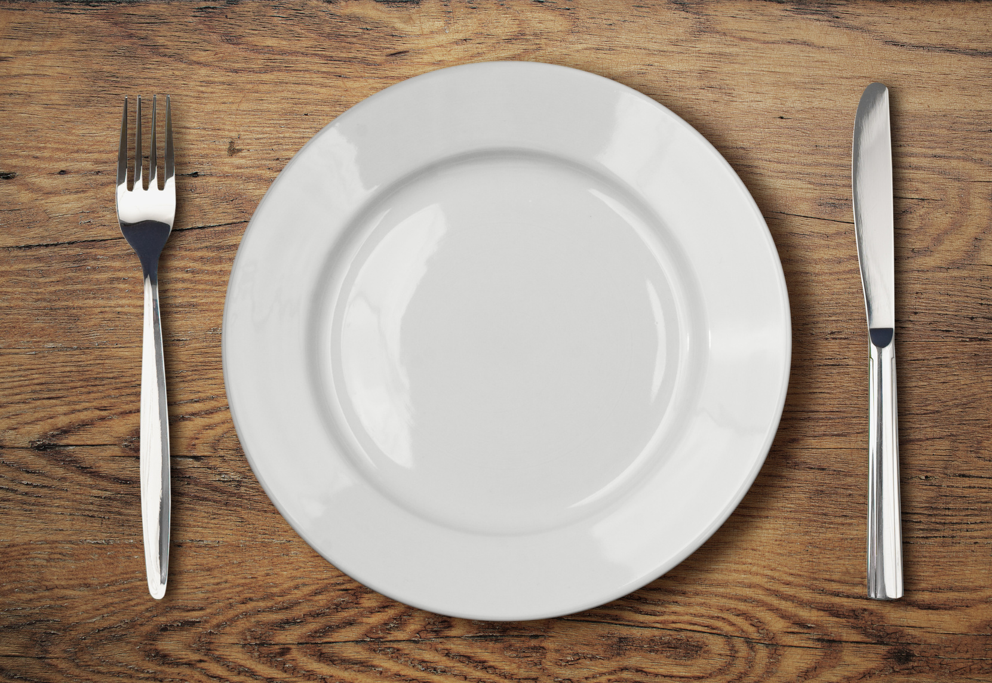
Understanding macro-nutrients
PROTEIN
CARBS
Protein helps for muscle growth, tissue repair, and immune function.
Carbohydrates are the fuel that give you energy throughout the day.
FATS
Fat also provides energy & regulates hormone production, as well as absorbing fat soluble vitamins which are required to maintain good health.

Slide 15
How protein affect blood sugar levels

Slide 16
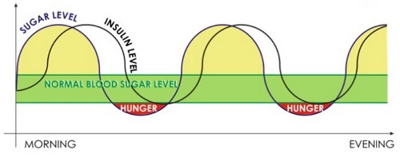
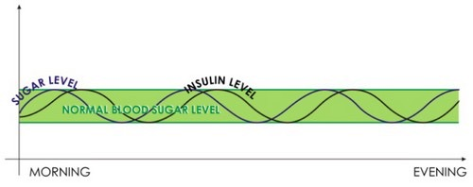
Excess insulin triggers sugar craving
Your blood sugar and energy levels should be slow and steady not swinging wildly up and down

Slide 17
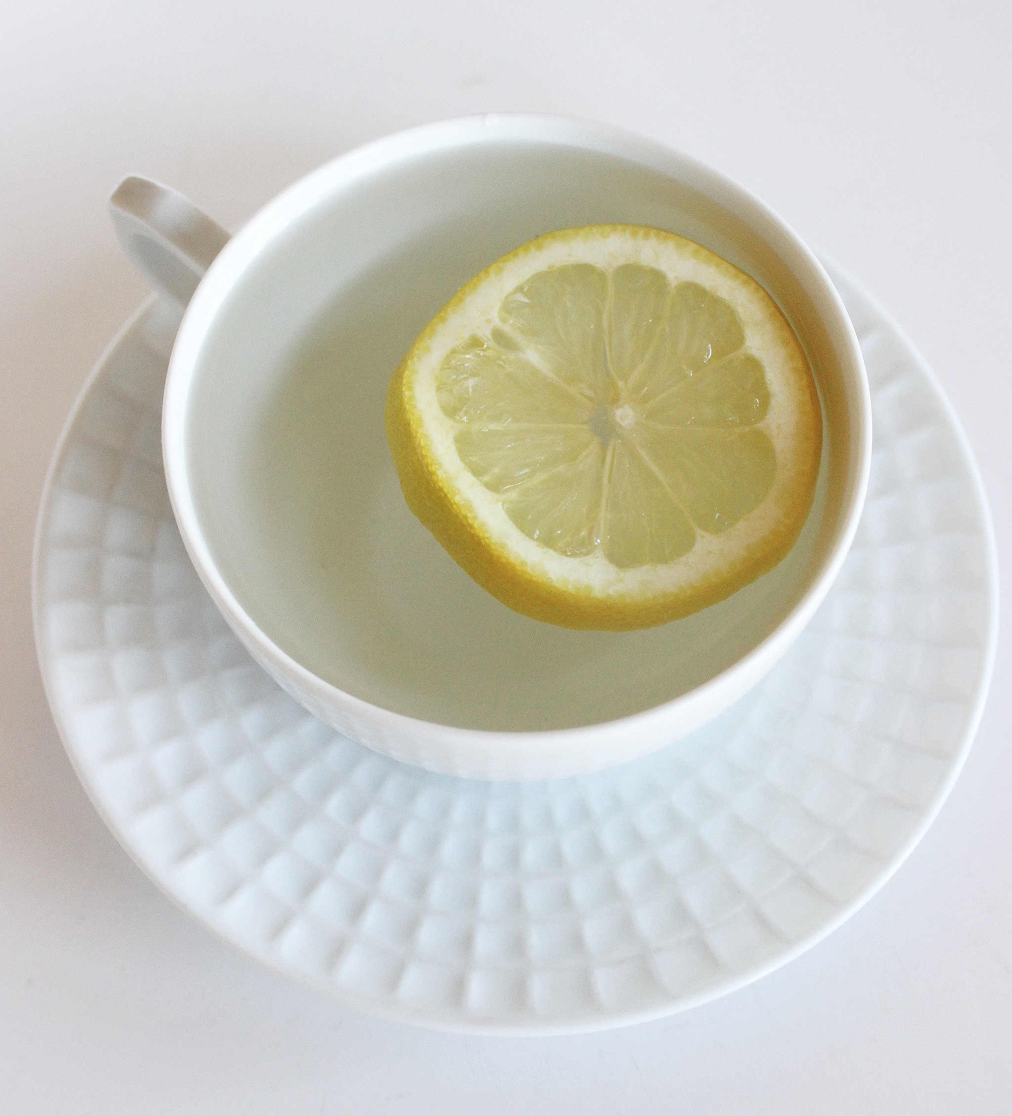
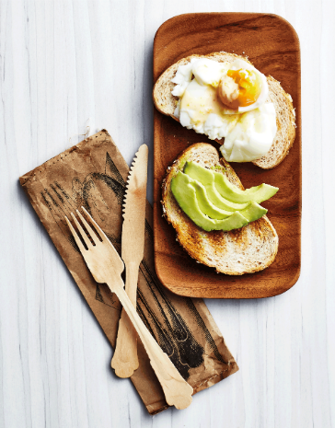
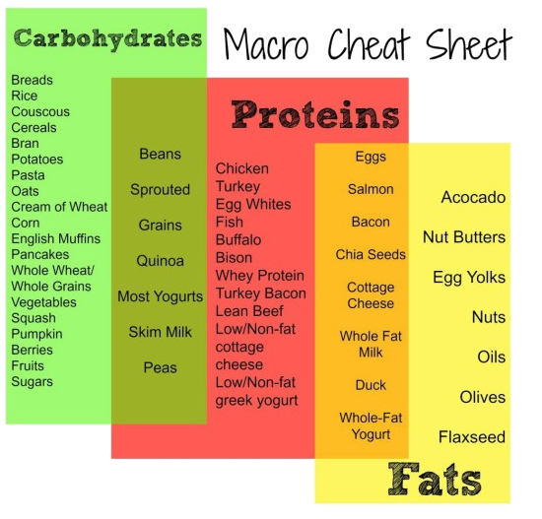
Energy boosting Foods
UP THE B’S
B vitamins are directly involved in creating energy at a cellular level & will give you an energy boost
Green vegetables
Asparagus / Spinach
Broccoli
Yoghurt
Chicken / Turkey / Salmon
Whole Grains / Brown rice
Almonds / Pecans
Eggs
A BALANCING ACT
Keep your sugar levels under control.
MIGHTY MAGNESIUM
Magnesium is involved in over 1000 enzymatic reactions in the body. It's vitally important in providing our cells with energy
Green vegetables
Nuts
Pulses
Fish
Bananas
DEHYDRATION CAUSES HEADACHES,
TIREDNESS AND CAN HINDER YOUR MENTAL
PERFORMANCE AT SCHOOL

Slide 18
3. SLEEP, REST & RECOVERY

Slide 19
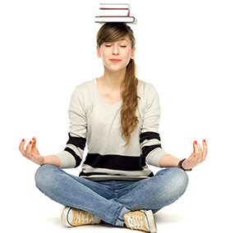
Thinking about your daily and weekly
routines, would you say you get enough
rest, relaxation or down time?
Why is it so important to rest and recharge ourselves?

Slide 20
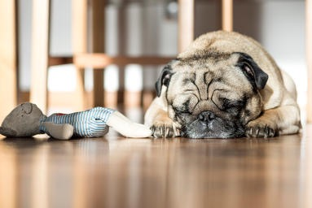
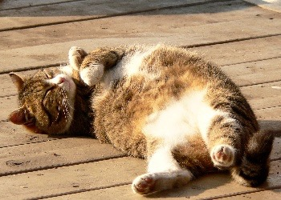
The Power of Rest
Regeneration of our bodies
Required for life
Helps us survive
Renew and restore cells
Keeps us functioning well
Rebuild & revive ourselves
Productivity & concentration
Efficiency at school or work
For growth & development
To replenish our muscles, bones, tissues & cells
Resting is awesome!

Slide 21
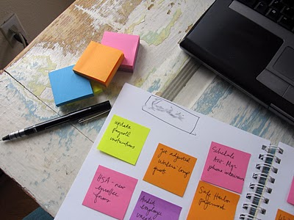
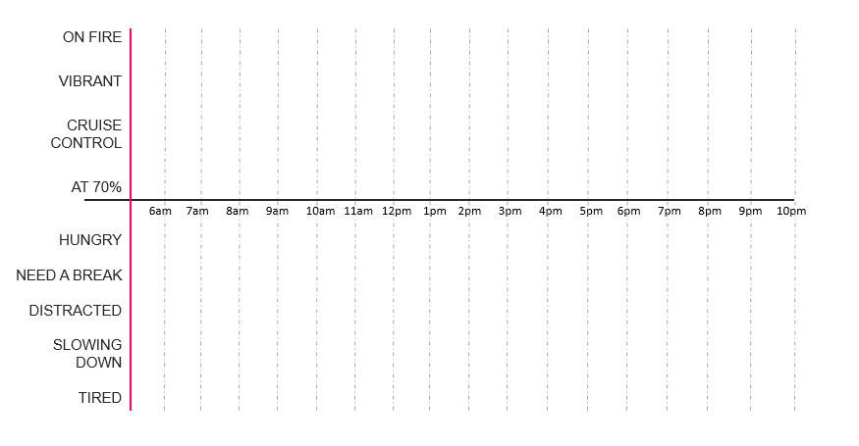
Your ideal work schedule
Plot your day from waking up to going to sleep in hourly blocks and identify when you are naturally:
Circadian rhythms
ON FIRE
VIBRANT
CRUISE CONTROL
AT 70%
HUNGRY
NEED A BREAK
DISTRACTED
SLOWING DOWN
TIRED
HUNGRY

Slide 22
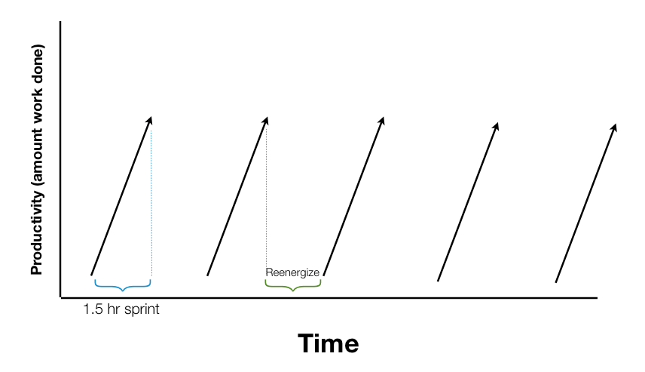
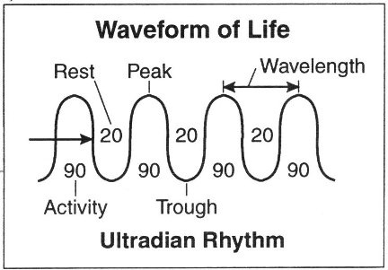
During revision - work in
60 to 90 minute intervals
Your brain uses up more glucose than any other bodily activity. Typically you will have spent most of it after 60-90 minutes
So take a break: Get up, go for a walk, have a snack, do something completely different to recharge.
PRODUCTIVE PEOPLE WORK SMARTER, NOT HARDER.

Slide 23
Lack of sleep
You need 8½ to 9 hours sleep per night

Slide 24
What happens if you don’t get enough sleep?
Reduced decision-making skills
Poorer memory
Reduced concentration
Reduced work efficiency
Shortened attention span
Increased risk for weight gain, depression, diabetes and cardiovascular Disease
Reduced alertness
Poorer judgement
Reduced awareness of the environment and situation
Slower than normal reaction time

Slide 25
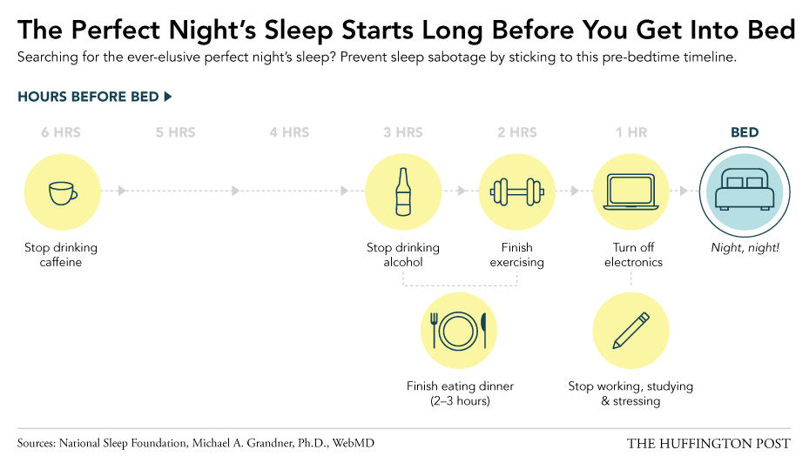
Think about how you can change your routine to get a better night sleep...
Stop drinking caffeine
Stop drinking sugary drinks
Finish exercising
Turn of technology
Night, Night
Finish eating dinner (2-3 hours)
Stop working, studying & stressing

Slide 26
Top tips to maintain your energy level tips
HYDRATION
Aim for 2 litres of water a day & more if you exercise
Drink a glass of water in the morning after you wake up or hot water with a piece of fruit in
Drink a glass of water after every caffeinated drink you have throughout the day
Carry a bottle of water around with you
Watch your caffeine and sugar intake
LIFESTYLE & PLANNING
Review & adopt a healthy lifestyle
Set goals & challenge yourself
Plan & manage your time effectively – prioritise weekly
Identify mood triggers – plan for them
Relax, unwind & have fun
NUTRITION
Eat breakfast everyday
Eat every 2-3 hours
Eat protein early on in the day and with every meal
Keep your blood sugar levels in check
Keep some healthy protein snacks with you
Focus on a balanced diet and whole foods
Plan your meals
Balance daily food choices with healthy variety
ACTIVITY
Understand your own circadian rhythms
Get a good nights sleep
Get some fresh air during the day
Take regular breaks to walk around
Keep active every day & exercise

Slide 27
4. Mindset & Managing Stress

Slide 28
How do exams make you feel?
Anxious
Tension
Worried
Moody
Irritable
Panic Attacks
Fearful
Tiredness
Pressured
Scared
Lack of sleep
Headache

Slide 29
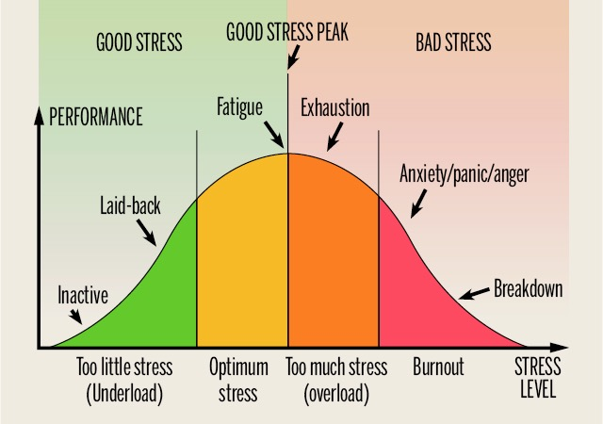
Is stress Harmful or Helpful?
Stress is a state of mental or emotional strain or tension resulting from adverse or demanding circumstances.

Slide 30
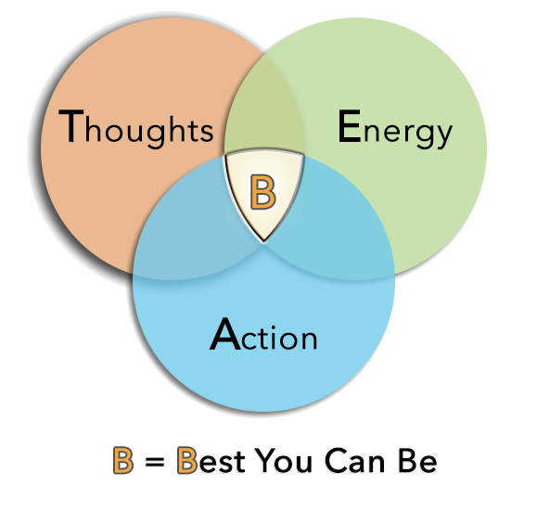
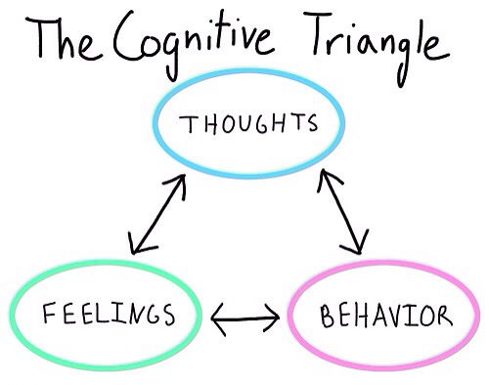
Thoughts, behaviour & emotions
Notes:
Your thoughts impact your behaviour
Stress comes from our perception of the situation
Technically, the actual situation is not stressful, our perceptions MAKE IT stressful
Sometimes we are right, sometimes we are wrong!
There are common unhelpful patterns of thinking

Slide 31
Managing Stress
PUT ASIDE WHAT IS OUT OF YOUR CONTROL
How people respond to you
Other people’s feelings
Otherwise you will:
Feel hopeless
Feel anxious
Feel STRESSED

Slide 32
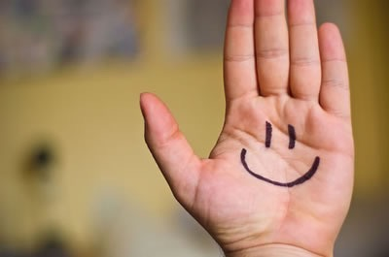
Use Positive Self-talk
It’s as simple as A-B-C:
A=Activating Event
While taking a difficult test you begin to feel physically tense.
B=Belief
“When I feel like this I always mess up. I can’t stop it!”
C=Consequences
You get a full blown anxiety attack and go completely blank.
A - Plan in advance what you will do when the activating event occurs.
B - Develop a set of positive or rational self-statements which you can practice.
C - You will help calm yourself down and re-divert your energy to being more positive

Slide 33
Self-statements
After this session write down all the different types of statements you could use to help you when you are thinking negatively prior or during an exam.
“I have prepared well, I can pass this test.”
“There probably will be some questions I can’t answer, but that doesn’t mean I can’t get a good grade.”
“I don’t have to get an A, I just have to pass it.”
“People who finish early and leave don’t necessarily know more than I do, they just work faster or they don’t know their material and can’t answer many questions.”

Slide 34
How to Calm Down in Under a Minute
Breathe in through your nose and on a slow count of three
Push your stomach out as you breathe in
Breathe out through your mouth on a slow count of six
Repeat two more times
Tips
If you feel light-headed, breathe more slowly.
Practice three times a day and you will remember the steps when you are stressed out.

Slide 35
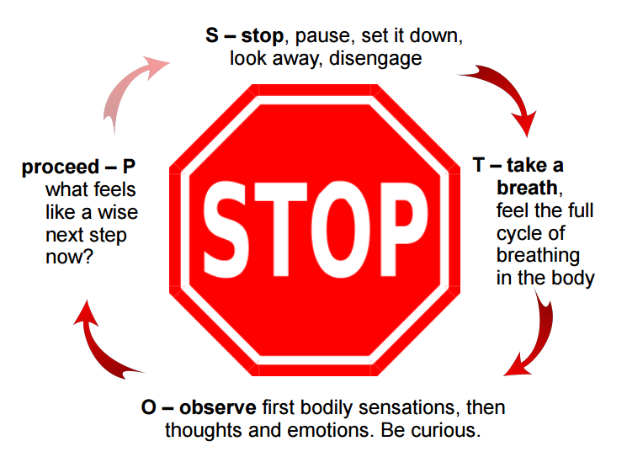
The STOP practice
Stop.
Take a breath.
Observe your thoughts and feelings.
Pause. Proceed mindfully.

Slide 36
The mindful unplug
Try to unplug from technology everyday
Switch off from technology at least 30 mins- 1 hr before going to sleep
Appreciate the world around you and what you are doing rather than being governed by your phone
Put your phone away & on silent while you are concentrating on tasks / revision / homework
Learn to have the control to not be obsessed with your phone!
Choose some time each day and week to switch off and unplug from technology

Slide 37
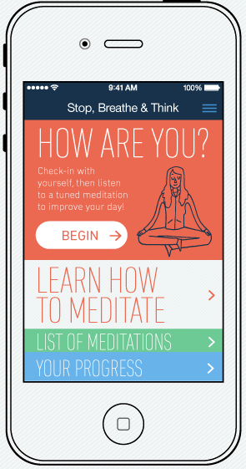
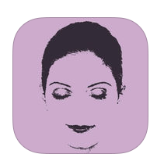
There’s an App for that…
Stop, Breathe, and Think - It opens with a short “interview” about how you are feeling, and then the app recommends guided meditations for their current state.
Take a Break! This provides short guided meditations for stress relief.
Smiling Mind - This app was designed for students.

Slide 38
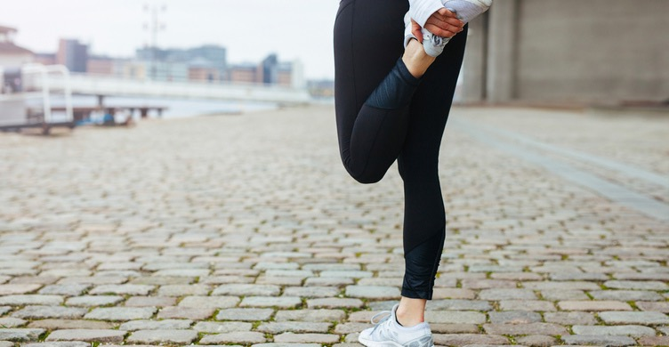
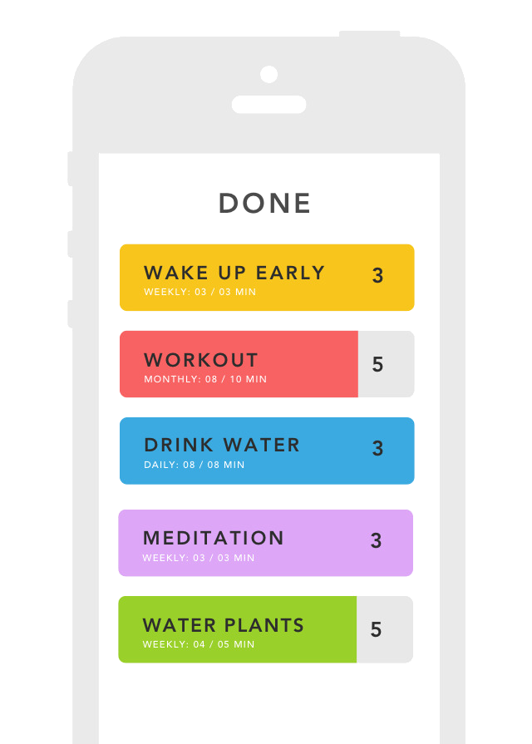
Top things you can be doing to look
after yourself & your health
Plan & prioritise your time weekly
Study for no more than 60 – 90 mins at a time
Take breaks away from revision and do something different
Try to continue your daily habits as usual (don’t drastically reduce your sleep, eliminate exercise, or overeat)
Be active regularly
Eat nutritious foods
Connect with others & talk
Do something you enjoy
Learn how to relax & take time out
Manage your time & commitments
Stay hydrated
Get enough rest & sleep
Be positive
Ask for help

Slide 39
THE BIG FOUR –MAKE SMALL CHANGES TODAY
1. Becoming more active
Set aside time
Start simply
Commit to a plan
Focus on consistency
2. Proper diet & nutrition
3. Sleep, rest & recovery
4. Mindset & managing stress

Slide 40
My 5 Stress Busters
Some challenges last for a long time. When facing a difficult situation, having a range of coping strategies is best.
Stressful Situation:
_________________
My 5 Actions:

