Slide 1
Exploring Parliament – with a detour on europe
Department of Politics and International Relations
Dr. Mark Shanahan, Director of Teaching & Learning, Department of Politics and International Relations, University of Reading

Slide 2
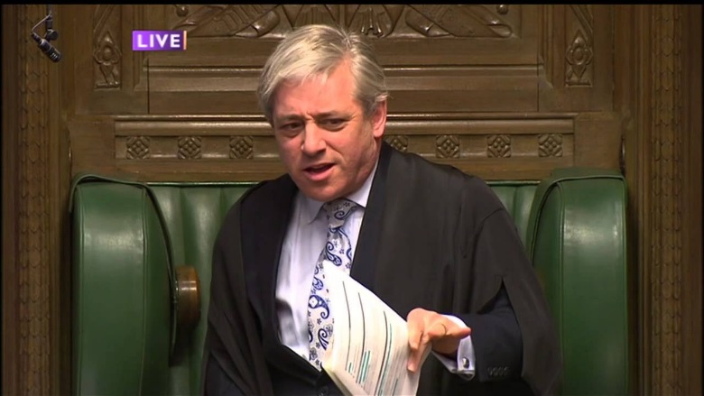
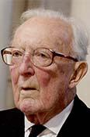
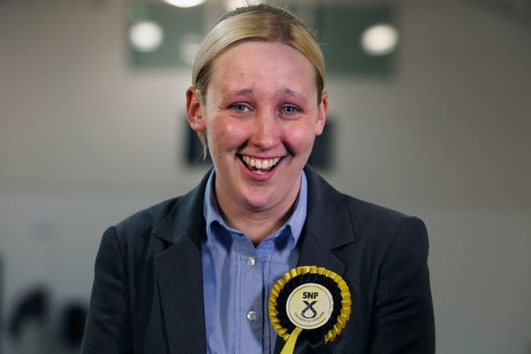
Who’s who?

Slide 3
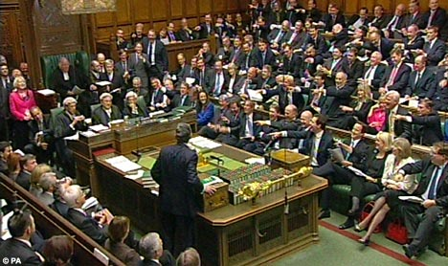
PMQs

Slide 4
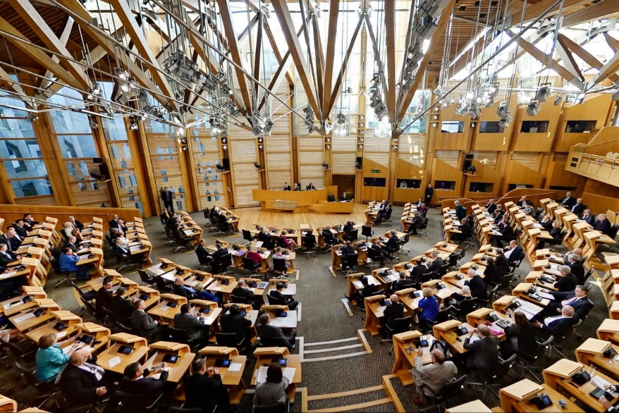
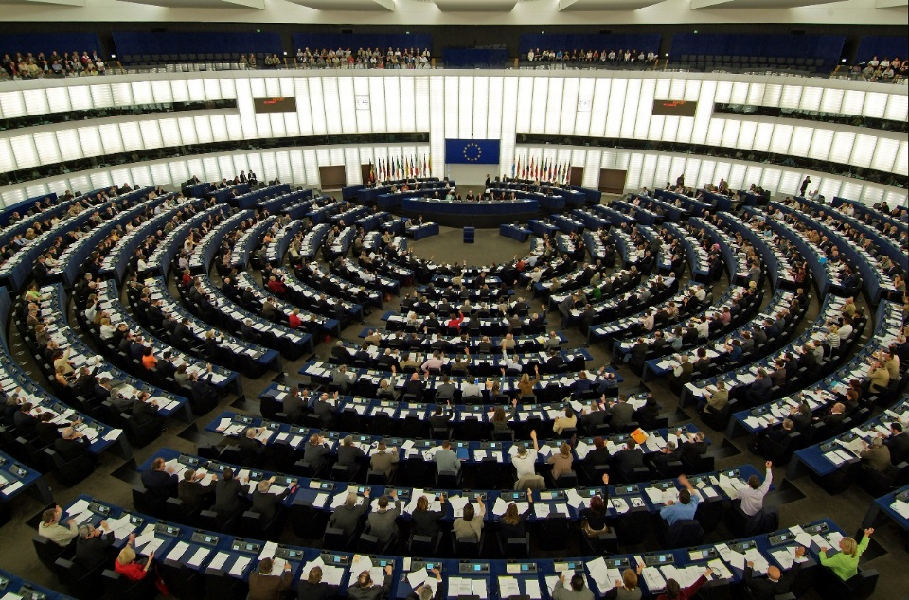
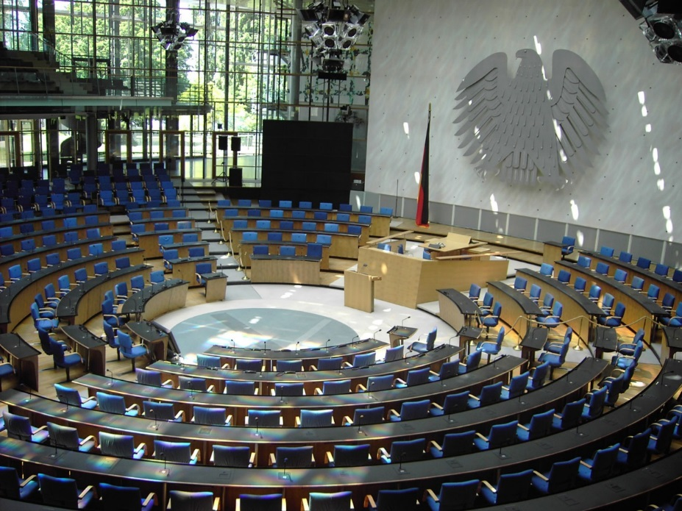
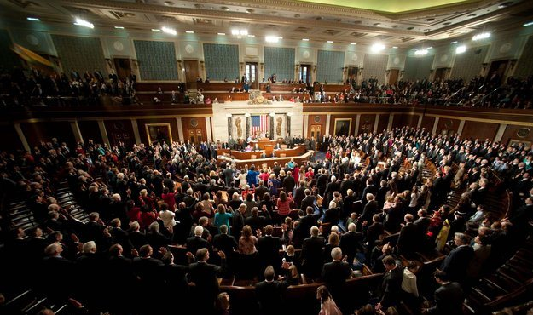
Alternatives

Slide 5
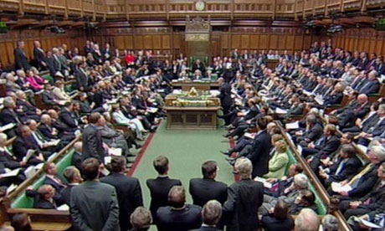
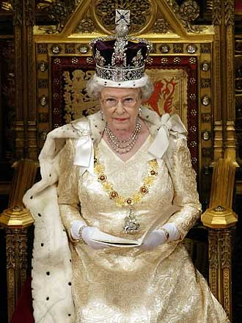
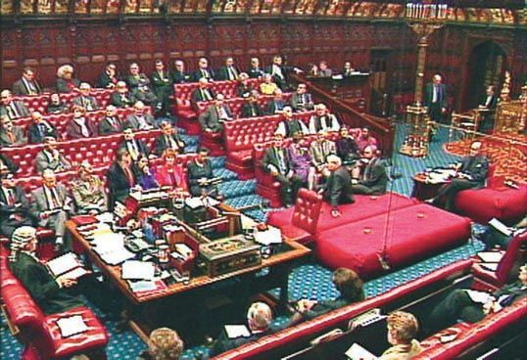
The 3 parts of Parliament
House of Commons
The Monarch
House of Lords
Notes:
Parliament comprises three parts: the two Houses of Parliament and the Crown in Parliament: all three must agree on a single text of a Bill before it can become law. Making the law is the function in which Parliament is “sovereign”.
The House of Commons
The elected chamber of Parliament – 650 MPs each representing a single geographical area (other Parliaments, at an extreme the Israeli and Dutch have no geographical link for Members). This link is an important influence on the way MPs think. In Scotland and Wales there are both constituency and “regional” Members.
The House of Lords
The “upper” House but since the civil wars and certainly since 1688 most definitely the second chamber of Parliament
Has changed quite dramatically since 1948 (and at an accelerating pace in the last two decades) from a sleepy backwater to a rather assertive “revising” Chamber, and greatly expanded its range of instruments (eg select committees). Has now lost its appellate committee to the Supreme Court (in 2009) and its Lord Chancellor to the Commons.
The Monarch
Her Majesty the Queen as the Crown in Parliament and Head of State
Signs off laws passed by Government – Royal Assent
Opens Parliament each year – a ceremonial role when she also reads the Queen’s Speech, which outlines the aims of ‘her’ Government
Until the passing of the Fixed-term Parliament Act 2010, the Queen, upon request of the Prime Minister, could dissolve Parliament by an exercise of “prerogative power”. Now she has to be asked by the House of Commons – an example of the long process of transfer of sovereign prerogative to democratic legislature.
AV Dicey defined prerogative power as: “The residue of discretionary or arbitrary authority, which at any given time is legally left in the hands of the Crown”.
The UK Parliament is sometimes described as the oldest in the world, but it depends what you mean by “oldest”, “Parliament” and “world”.

Slide 6
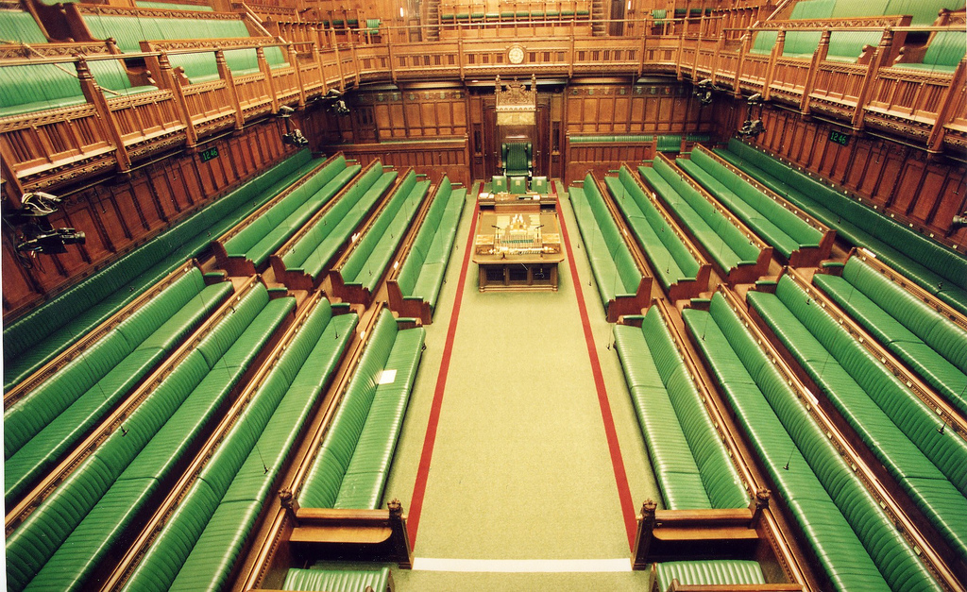
House of Commons
The official opposition
The Speaker and deputies
Governing Party
232 MPs
330 MPs
56 MPs
Other Parties and Independents
33 MPs
Notes:
6

Slide 7
Figures accurate as of July 2014

Slide 8
Notes:
The current House of Commons is a relatively ‘young Chamber. More than 50% of MPs were elected at the 2010 or 2015 elections.
Around two thirds have 10 years experience as MPs or less.
Figures accurate at May 2015

Slide 9
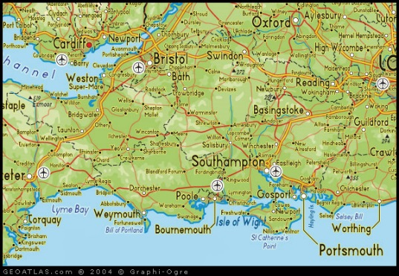
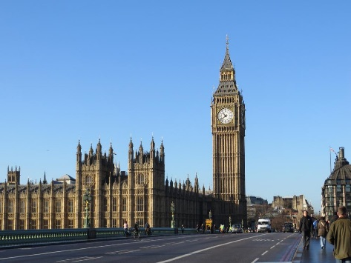
The Work of an MP
Holds advice surgeries
Helps constituents with problems
Visits groups and individuals to hear issues/ concerns
Represents constituents to various bodies
Campaigns
In constituency
In Westminster
Raises issues in Chamber and Committee
Passes new laws
Scrutinises the work of Government
Meets with Ministers, campaigners, public bodies, media
Attends party meetings/ business

Slide 10
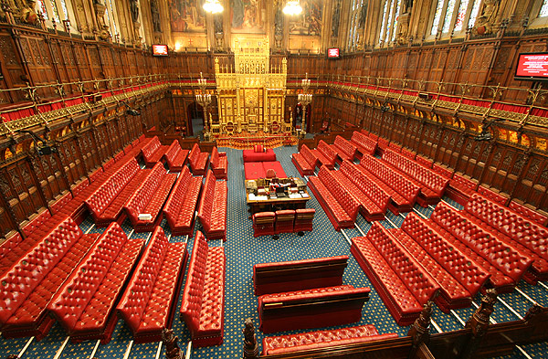
House of Lords
Archbishops/ Bishops
25
Lord Speaker
Official Opposition
Governing Party
211
Other Parties
138
224
(Inc.
101)
Cross-Benchers
176
Total :775
Notes:
NOTE: The government does not have a majority! (and nor did the Coalition government).
Lords evolution over 900 years
Life Peerages Act 1958 (first female Peer)
House of Lords Act 1999 – all but 92 hereditaries expelled, 92 remaining hereditary Peers elected to remain
Appointed by the Queen – put forward by Prime Minister:
Political Party nominations
Independent cross bench nominations from Appointments Commission
39 peers currently appointed but not sitting (either through leave of absence, being members of Supreme Court or MEP) = 79

Slide 11
Notes:
The House of Lords does not have one party with a majority (over 50% of the seats).
Based on eligible members (not including members of the judiciary and those on leave of absence)
Figures correct as of October 2016

Slide 12
Main working differences between Commons and Lords
Time to debate
Debating amendments
Committee stage of bills
Role of speakers – regulation
Politicisation (although Lords changing)
Power – Parliament Acts – delay and finance
Notes:
Time to debate: there are less demands on the timetable in the Lords, and on the time of Members (no constituency work)
Amendments/ Committee: Legislation is not subject to a Programme Motion in the Lords. All proposed amendments to Bills can be debated – not selected by Lord Speaker/ committee chair.
Role of Speakers: Lord Speaker more ceremonial/ figurehead. Not ‘referee’ like Mr Speaker.

Slide 13
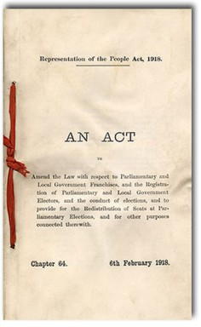
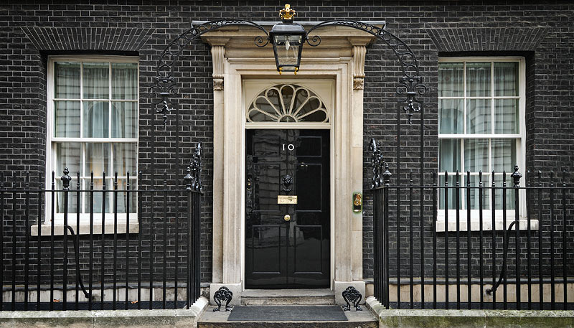
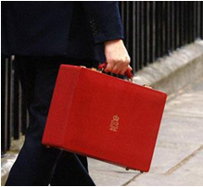
What does Parliament do?
Makes the law
Scrutinises the work of government
Enables the Government to generate & spend taxes
Notes:
Redress of grievances
Constituency casework
Petitions
Backbench debates (badgers, care homes, etc, etc.)
Taxes
The House of Commons must approve (and renew) all taxes, and “appropriates” all the money so raised to specific (and legally binding) purposes. This was once at the heart of the Chamber’s work and took many weeks. Now it is largely formulaic, and the real work is done by the select committees who “follow the money”. This is what we nowadays call “Scrutiny”.
Legislating – to make and pass laws
It is not possible for the government to just create laws and implement them without the approval of Parliament – except in the case of a large proportion of the 100 or so SIs made each year – any bills (draft laws) must be examined and a single text agreed by both Houses before the bill can become a law.
Although the Lords in theory is an equal partner in making the law, the Parliament Acts 1910 and 1949 established its subservient status – the Commons can (and occasionally does) make the law itself, and this reserve power is more important in subduing the Lords than its actual exercise.

Slide 14
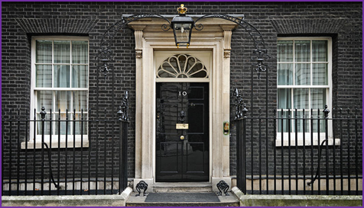
Who is the Government?
The Prime Minister
The Cabinet
Government Whips
Office of the Leader of the House of Lords
Notes:
The party which can command the majority of MPs forms the Government.
There are 22 Cabinet Ministers, including the Prime Minister
There are 8 other Ministers who also attend Cabinet
The senior Whips are technically members of the royal household with rather Ruritanian official titles.
Baroness Stowell of Beeston MBE is Leader of the House of Lords
14

Slide 15
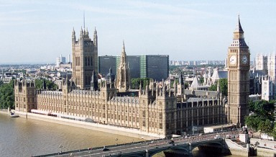
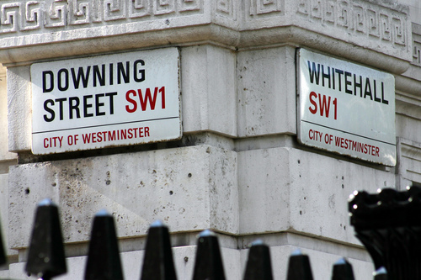
Parliament (Westminster)
Government (Whitehall)
Commons, Lords,
Monarch
Holds Government
to account
Passes laws
Enables taxation
Represents public
Raises key issues
Formed by the party who can command the confidence of the Commons
Some MPs and Lords
Runs Government departments and public services
Accountable to Parliament
Notes:
The political party (or parties) which can command the majority of seats in the House of Commons forms the Government
The Government proposes and Parliament disposes; this is true of money definitely and laws generally.
The Government consists of 110 members, all of whom are chosen by the Prime Minister and approved by the Queen
The Prime Minister can choose whoever they want to be a member of their Government but the convention nowadays is that they must be a Member of one or the other House of Parliament (but mention tsars and goats)
The Government runs the country – Parliament is there to make sure it is kept honest
A lot of what is done by departments is done by administrative action however, not under statute – which is where more wide-ranging scrutiny is necessary
It is only through legislation that Parliament can command the Government, although its most important power (which belongs only to the House of Commons) is the raising of taxes to fund what the Government does and the approval of the Government’s expenditure plans. The “withholding of Supply” is the nuclear option (could mention the Lord Chancellor’s Bathroom in 1919 as the last time an Estimate was reduced) (Mention ignoring of BBCom resolutions?)

Slide 16
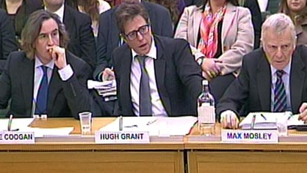
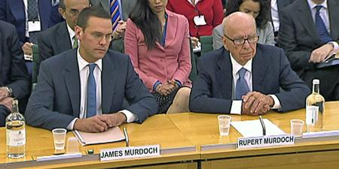
Parliamentary Mechanisms
All Party Parliamentary Groups
Early Day Motions
Debates
Legislative debates & committees
Select Committees
Questions

Slide 17
Some outputs - House of Commons 2010-2015
182 Urgent Questions
153 Acts of Parliament
1685 select committee reports
5669 EU docs examined
236,839 oral and written questions
6337 select committee meetings
733 sitting days

Slide 18
How is business chosen and controlled?
Government
The role of the whips and Leader(s) of the House(s)
The Speaker
The Backbench Business Committee (Commons)
House Business Committee?
Notes:
Whips
Whips are MPs or Lords appointed by each party in Parliament to help organise their party's contribution to parliamentary business. One of their responsibilities is making sure the maximum number of their party members vote, and vote the way their party wants.
Whips frequently act as tellers (counting votes in divisions). They also manage the pairing system whereby Members of opposing parties both agree not to vote when other business (such as a select committee visit) prevents them from being present at Westminster.
Whips are also largely responsible (together with the Leader of the House in the Commons) for arranging the business of Parliament. In this role they are frequently referred to as 'the usual channels'.
The Whip
Every week, whips send out a circular (called 'The Whip') to their MPs or Lords detailing upcoming parliamentary business. Special attention is paid to divisions (where members vote on debates), which are ranked in order of importance by the number of times they are underlined. Important divisions are underlined three times - a 'three-line whip' - and normally apply to major events like the second readings of significant Bills.
Three-line whips
Defying a three-line whip is very serious, and has occasionally resulted in the whip being withdrawn from an MP or Lord. This means that the Member is effectively expelled from their party (but keeps their seat) and must sit as an independent until the whip is restored.
Small majorities and whips
The job of the whips becomes more important if the majority of the party in government is small. This makes it easy for the government to lose in major votes. Therefore, it's crucial that the whips on both sides (government and opposition) try to get as many Members to vote as possible.
The Speaker
The Speaker of the House of Commons chairs debates in the Commons Chamber and the holder of this office is an MP who has been elected by other MPs. He is the chief officer and highest authority of the House of Commons and must remain politically impartial at all times. During debates the Speaker keeps order and calls MPs to speak.
The Speaker has full authority to make sure MPs follow the rules of the House during debates. This can include:
directing an MP to withdraw remarks if, for example, they use abusive language
suspending the sitting of the House due to serious disorder
suspending MPs who are deliberately disobedient - known as naming
asking MPs to be quiet so Members can be heard
The Speaker also represents the Commons to the Monarch, the Lords and other authorities and chairs the House of Commons Commission. The current Speaker is Rt Hon John Bercow, MP for Buckingham.
Leader of the House
The Leader of the House of Commons is a government minister whose main role is organising government business in the Commons. The Leader of the House does this by working closely with the government's Chief Whip. Rt Hon Andrew Lansley CBE MP is the current Leader of the House of Commons.
Scheduling business
Every sitting Thursday, the Leader of the House tells the Commons about the business scheduled for the following week and usually provisional business for the week after.
Committee membership
The Leader chairs a number of Cabinet Committees, including the Ministerial Committee on Constitutional Affairs and the Legislative Programming Committee.
Deputising for the Prime Minister
The Leader can deputise for the Prime Minister, either at Prime Minister's Questions or for formal duties, but ordinarily the Deputy Prime Minister fulfils this function.
History of the role
The title does not appear to have become established until about the middle of the nineteenth-century although the institution is much older. The leadership of the House is not a statutory office nor is the Leader formally appointed by the Crown; for these reasons the post has usually been held together with another office; recently this has usually been that of Lord President of the Council.
Until 1942 the Prime Minister, if a Minister of the House of Commons, generally also acted as Leader of the House, although day-to-day duties were frequently carried out after 1922 by an appointed deputy Leader. Since 1942 it has been the regular practice to have a separate Leader of the House, and there have also been instances of the appointment of a deputy Leader of the House.
The Backbench Business Committee
The House of Commons Backbench Business Committee is an 8 Member Committee chaired by Natascha Engel MP. It has a limited allocation of time outside Government control in which it can schedule subjects for debate suggested by backbench Members of Parliament.
The Committee can consider any subject for debate. This includes subjects raised in national or local campaigns, reports by select committees and other groups and issues suggested by constituents, including by people who have signed an e-petition or a traditional paper petition (there is no restriction on the number of signatures required).
In November 2012 the Procedure Committee published a report on the first two years of the Backbench Business Committee. The Chairman of the Procedure Committee, Charles Walker stated “The Committee has firmly established itself as a key tool for backbench MPs during the first two years of this Parliament. We now have the opportunity to make some small improvements and refine the framework in which the Committee operates, to ensure that this success continues.”
The Procedure Committee also made a number of recommendations to strengthen the role of BBBCom, however many of these have not yet been implemented by the Government
House Business Committee
In November 2009, the Select Committee on Reform of the House of Commons (the Wright Committee) recommended the establishment of a House Business Committee to “assemble a draft agenda to put to the House in a weekly motion”. On 4 March 2010, the House approved the establishment of a House Business Committee in the current Parliament.
The Coalition Agreement committed the Government “bring forward the proposals of the Wright Committee for reform to the House of Commons in full” and said that “A House Business Committee, to consider government business, will be established by the third year of the Parliament”. Early in the current Parliament, ministers confirmed this intention and answered questions on the remit, operation and composition of the House Business Committee.
On 16 May 2013, in evidence to the Political and Constitutional Reform Committee, the Leader of the House of Commons, Andrew Lansley, said that:
… the Coalition programme commitment to the establishment of the House Business Committee in the third year of Parliament will not be met. From my point of view it is not the abrogation of the commitment to pursue the principle of a House Business Committee, but what I am saying is we are now exercising a reality check and recognising we are not in a place to do this yet.
Possible question for discussion: Would a House Business Committee detract from the Backbench Business Committee? If so, would it be worth doing?
18

Slide 19
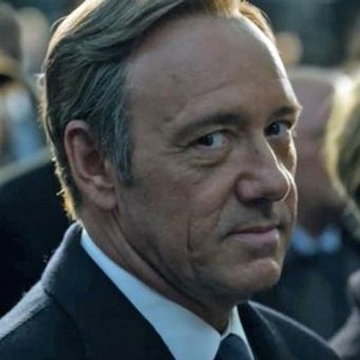
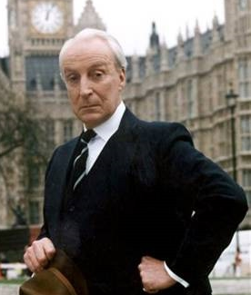
Voting and the role of the whips
Maintain party discipline
Get government/ party’s business through Parliament
Link between front and back bench
Communicate businesses for the following week
Pastoral role as well as disciplinarian
Withdraw the whip – expel from the party
Notes:
MPs vote on bills and suggested amendments as part of the legislative process.
They can vote as they wish, but generally they are expected to vote with their party. (Independent MPs do not belong to a party, and therefore do not have a party whip.)
If Government has a large majority then voting is not usually an issue; however, if majority is small or the issue is contentious, then Whips will come into action.
Whips are MPs who help maintain discipline in the party and issue directives about which way members are expected to vote on certain issues. Each main party has a Chief Whip with about 12 Whips – the term Whip was first used in the 18th century - as party organisers likened to person on a hunting field who whipped in the hounds in the pack to keep them all together.
Whips communicate with their party by sending out an MPs notice, known as The Whip, giving the order of business for the following week. Each matter to be discussed will have one, two or three lines scored underneath it. Underlined once – it is not particularly important. Underlined twice – it is important and attendance is requested. Underlined 3 times and attendance is essential – hence a 3 line Whip.
A member is also traditionally allowed some leeway if the interests of her/his constituency are adversely affected. In some circumstances, however, parties announce free votes allowing members to vote as they please. Votes relating to issues of conscience such as abortion and capital punishment are typically free votes.
MPs vote by going into one of 2 lobbies (rooms) the aye lobby or the no lobby where they are counted as they leave.
Tell delegates that can find out how their MP voted at www.parliament.uk
If the whip is withdrawn the MP is expelled from the party, but still retains their seat.
Occasional revolts occur. (Give an example of a recent vote which went against Government. The most recent one at the time of writing was 29th April 2009. Ayes = 26, Noes = 246 Motion to retain wording of a Liberal Democrat opposition motion calling for the withdrawal of eligibility guidelines which allowed some Ghurkhas to live in the United Kingdom and calling for revised proposals that allow an equal right of residence for all Ghurkhas, and to oppose an amendment supporting Government policy). All government defeats are recorded in a document.
19

Slide 20
Parliament’s administration
House of Commons Commission
House of Lords Administration
Clerks & procedural staff, Hansard
Commons and Lords Libraries, POST
Security, catering, estates, IT
Public engagement and education teams
Notes:
The Commission provides the non-executive governance of the House by Members, but it does not manage day to day operationsIt has delegated this power to the House of Commons Management Board, by an Instrument of Delegation.
The House of Commons Management Board
The Management Board oversees the operational functions of the House and develops the House’s policies, budgets and strategic planning, which are endorsed by the Commission. The Chief Executive, who is also the Clerk of the House of Commons, chairs the Management Board. The other members are the heads of the five departments of the House, the Director of Parliamentary ICT (a bicameral department serving both the House of Commons and Lords) and two external members appointed through open competition.
Below the Management Board are the five departments which make up the House of Commons Service. These are Chamber and Committee Services, Facilities, Finance, Human Resources and Change, and Information Services. Parliamentary ICT is provided by a joint department of both Houses. The Office of the Chief Executive sits outside the departmental structure and supports the Chief Executive and the Management Board in functions such as strategic and business planning, risk management, coordination of business resilience, internal communications and internal audit.
Both the Commission/Members Estimate Committee and the Management Board are advised by the House’s two Audit Committees: the Administration Estimate Audit Committee and the Members Estimate Audit Committee.
DCCS: guide you through the system.
DIS: research and outreach
Facilities: buildings and food
Finance and DHRC: of less interest to MPs these days than IPSA

Slide 21
Some numbers to crunch
1764 staff
4,000 people working in 9 buildings
24,786 individual enquiries from the public answered
1,416,000 meals served
22,918 pages of Hansard published
90 research papers published
22,642 research inquiries dealt with
66.5 million hits on the Parliament website
131,522 visitors to Chamber
Notes:
Figures relate to the House of Commons, 2014-2015

Slide 22
Influences on MPs
Political parties
Constituents
APPGs
Pressure groups/ NGOs
Think Tanks
Commercial lobbyists
Social media
Wider campaign groups
Notes:
Political parties:
As well as main party policy, MPs may be members of inner party groups – Bruges Group, Orange book (Lib Dems), Tribune (Labour)
Some straddle parliamentary parties and wider party – Conservative Home, Left Foot Forward
APPGs:
Quotes from the Committee on Standards Oral evidence on APPGs
Mark D’arcy BBC Journalist: ” having an informal ecology of lots of little groups beavering away at particular issues and learning about particular places or diseases, or whatever it is, is incredibly valuable to this place, and needs to be preserved “
Ann Coffey MP “Lobbying is part of the parliamentary process, and it is right that people from outside feel that they can contribute to the democratic decisions that are made. It is the strength of democracy. “
Douglas Carswell MP “It is very tempting to say that all these lobbyists are suckering their clients and giving them a whole load of bluff about the extent to which they have influence and, therefore, that is nothing to do with us. I broadly agree with that, until they start running things called All-Party Parliamentary Groups and using this place. Go and stand in the dining room on a regular weekday, look at how many APPGs are holding events there, and ask yourself, “Is it genuinely, in each case, a group of MPs coming together in order to promote something, or is it a lobbyist who is using that as a way of getting access into the building to impress their clients?” I think a distinction needs to be made. If a big corporate organisation is going to be suckered by lobbyists, that is their problem, but if they are going to start using the House of Commons or the name of APPGs, I think that that is wrong, and it devalues and debauches the whole currency of Westminster if we allow them to do it.”

Slide 23
Contemporary issues
Growing assertiveness of backbenchers
Prominence of constituency work/ concerns in MPs decisions
Increasing numbers in House of Lords -internal calls for reform
Physical Restoration and Renewal
Composition of chambers – rise of SNP, ‘younger’ members
Role of technology in public engagement & political discourse – e-petitions, Twitter, 38 Degrees

Slide 24
Some questions to ask ourselves & debate topics

Slide 25
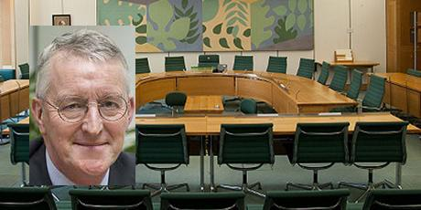
What should Parliament's role be in relation to Brexit?
http://www.parliament.uk/hleu
Split into groups; 5 minute debate
What should be the role of :
The House of Commons
The House of Lords
The Government?

Slide 26
Exiting the EU

Slide 27
Restoration or abandonment?
Notes:
Restoration & renewal of PoW is vital if it is to remain seat of Parliament
Mr Speaker asserted that the cost of restoration and renewal of the Palace would cost ‘not inconsequential’ sums of public money
Estimated at £5.7bn over 32 years if MPs and Lords were to keep using the Palace, or £3.5bn over 6 years of Palace were vacated
For discussion:
Should the expensive work take place?
Should Parliament relocate?
If it were to relocate, should it move outside of London?
What are the case for and against these questions?
What are the implications for our democracy?

Slide 28
Thanks – any final questions?

