Slide 1
Year 12 Induction Evening for students and parents
29th September 2016

Slide 2
Welcome
The Sixth Form team
Head of Year 12 Toby Jessop
Key Stage 5 Leaders Gisella Vignali
Steve Rayner
Sixth Form Manager Chris Bullion
Sixth Form Administrator Sharon Bell
Head of Year 13 Richard Hand

Slide 3
Aims of the Sixth Form
To work with students and parents to ensure that our young people achieve, not only academically, but also develop the skills and attributes which are essential to success in later life.

Slide 4
Easing the transition to KS5
Our expectations of students
Growth mindset – perseverance & resilience
Agreement
Hard work
Study skills/time management
Effective use of supervised study periods

Slide 5
Plan for the future
Prioritise commitments
Social life
Part time job
SCHOOL WORK
(16 hours per week outside school
Sixth Form Centre open from
7.30am to 5.00pm

Slide 6
Attendance
There is an obvious connection between good attendance and doing well
Attendance at lessons and registration is not optional
There is no “home” study – year 12 students are expected to stay in school all day
Students’ attendance is checked weekly and dealt with by a series of increasingly serious sanctions.
Persistent offenders will find that their future in the Sixth Form will be under review.

Slide 7
Mentors and Mentor Meetings
Bridge the gap between KS4 and university/career
Attendance at 8.50am & 2.05pm mentor session is compulsory. There will be some mentor weeks to enable intensive one to one meetings when the usual mentor sessions will be suspended.
Personal development guidance

Slide 8
A growth mindset
Notes:
Thought I’d start with a few reminders of Mr Ramsden’s message on Monday

Slide 9
YET! This is the key to moving forward.
Notes:
Clear message from this image that ability plays a part, but it is the effort you make that is the over-riding factor.

Slide 11
10 things that require zero talent:
Work ethic
Effort
Body language
Energy
Attitude
Being on time
Passion
Being coachable
Doing extra – going the extra mile; above & beyond
Being prepared for lessons in terms of equipment and background reading

Slide 12
Communication
Key to success at KS5
Talk to us – Sixth Form team, mentors and subject teachers
AS & A Levels are challenging! If you can do it easily, you’re not learning to the best of your ability!
Don’t let small issues grow into bigger issues
Persevere

Slide 13
Enrichment Activities
Subject based activities aimed at deepening student’s knowledge and interest in subject.
Competitions, extra reading, attending lectures at local universities, study days
Seek advice from mentors and subject teachers
Work experience

Slide 14
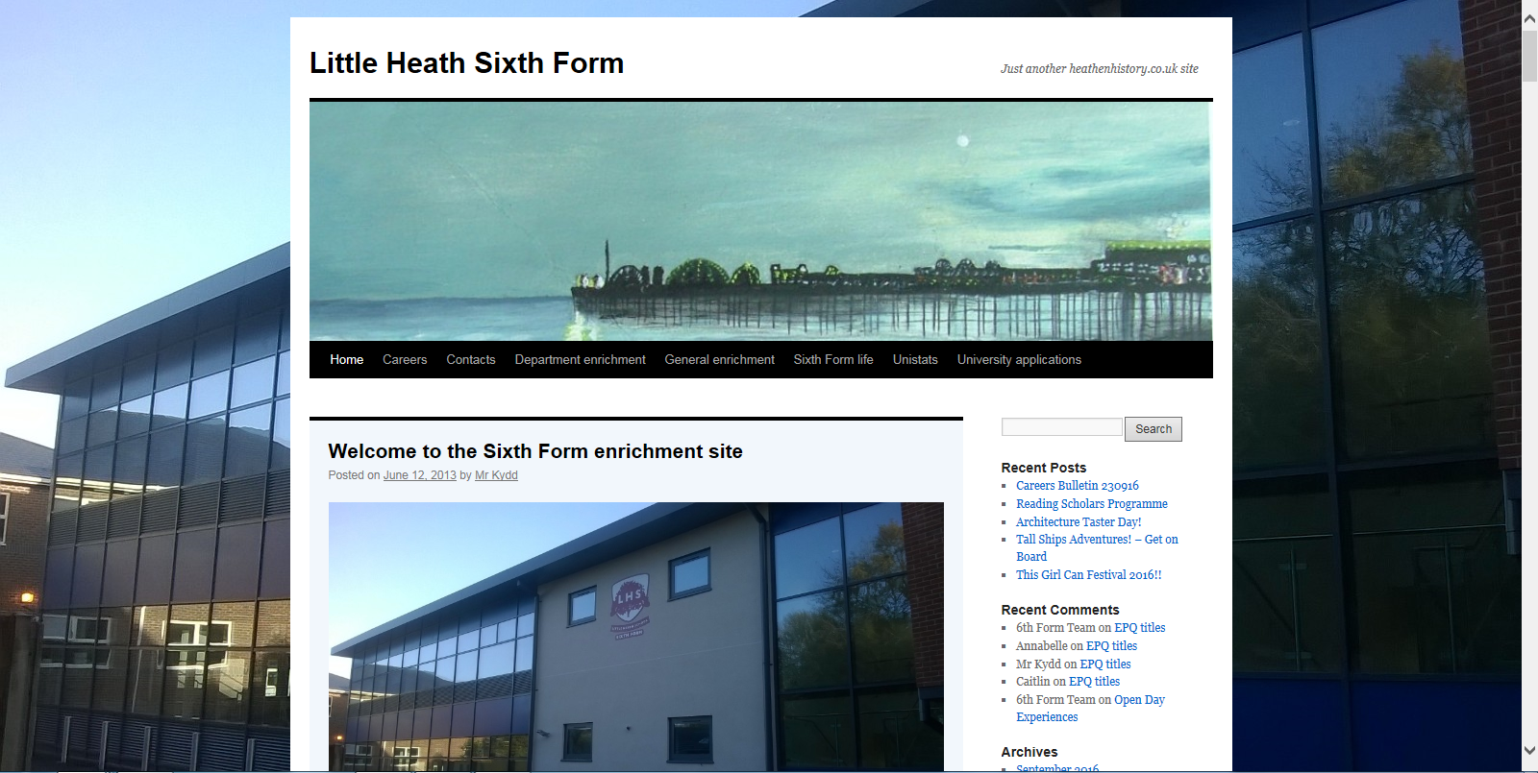

Slide 15
http://heathensixthform.co.uk/

Slide 16
Personal Learning Checklists (PLCs)
Developed by departments in all subjects at AS and A Level.
Student friendly checklist of knowledge and skills they will need to succeed in their subjects.
Students should be checking their progress against these regularly.
Available on heathensixthform website
Independent learning – using Study Journals

Slide 17
Lessons & Study Periods
Each subject has 8 teacher led periods + 2 Supervised Study periods, over the fortnight.
This means there are 10 periods per subject, equating to 40 periods of lessons (out of 50) for someone studying 4 AS subjects, over the 2-weeks.
The 2 periods of Supervised Study are part of the 10 lesson package, and are compulsory.
Study Journals have information and advice about additional & independent work to be completed in these sessions. Subject teachers may also set specific tasks to be completed in these study sessions.
Students need to record the work completed in each Study Period in their Study Journal – this will be checked & monitored by Mentors and subject teachers.

Slide 18
The Curriculum
A broad curriculum on offer:
Mostly new linear AS/A Levels with some modular courses (just 9).
4 AS Levels in Year 12
3 or 4 A Levels in Year 13 + EPQ
Opportunity to study a wide variety of courses.
Opportunities to re-sit GCSE Mathematics and English

Slide 19
Assessment
Students are taking either Modular or Linear AS/A Levels
A mix & match set up this year, with two systems running
9 subjects still Modular [Md/Fi/Pl/Mt/HE/Tx/RE/Ma/FMa]
Subjects Linear from Sept 2016
Art | Drama | History
Biology | Economics | Philosophy and Ethics
Business | English Language | Physics
Cambridge Techs in Business and ICT | English Literature | Physical Education
Chemistry | French | Psychology
Computing | Geography | Spanish
.

Slide 20
Assessment
Modular AS/A Levels
Students study 2 (or 3) units in each of their AS subjects. Most A Levels are made up of 4 (or 6) units.
The marks achieved in these AS units contribute to half of the final A Level grade.
An AS is a separate qualification, but it’s also half of the A Level
BTEC assessment 6 units – mostly coursework
.

Slide 21
Assessment
Linear AS/A Levels
Students study 2 (or 3) units in each of their AS subjects. Most A levels are made up of 4 (or 6) units.
Students will sit AS external examinations in most subjects in May/June. The exceptions are Drama, Spanish and PE who will sit internal assessments.
However, these marks do not contribute to the final grade, as this is based on all marks achieved in the final examinations at the end of Year 13.

Slide 22
Assessment
MODULAR or LINEAR:
Doing very well at AS Level, regardless of whether you are taking Linear or Modular courses, is very important.
AS results/end of year assessments will be a very good indicator of the progress students are making towards a great set of A Level grades. Typically, students will need to achieve at least a Grade D (preferably C+) to move onto the second year of the A Level course
They are the ‘gateway to success’ in Year 13.
Make the most of every opportunity offered by subjects and teachers this year and use time in school and at home wisely – especially study lessons! [Study Journals to be completed]

Slide 23
Key Dates & Assessment
Year 12 Introductory Report - sent home at the end of October/start of November, followed by Y12 Mentor Evening – Thursday 1st December 2016
The PPEs (Pre-Public Exams/Mock) will be held in January – in lesson times.
Year 12 Interim/Mock Report sent home around February half term
Year 12 Parents’ Evening – Thursday 23rd February 2017

Slide 24
Getting coursework right
Assessment objective of some KS5 subjects but crucial to success in Applied A Levels (Cambridge Technicals & BTECs)
New system for handing in assignments
Essential to break up tasks (chunk) and plan time effectively so that deadlines are met and the final product is the best piece of work a student can produce.
Where possible, get feedback from staff and improve the coursework – UPGRADE the coursework
Deadlines are online – look out for pinch points.

Slide 25
Target Setting - Aiming high
Year 12 students have all been given a Minimum Target Grade [MTG] based on how well they did at GCSE.
We ask students to think beyond these and set themselves personalised target grades which include some challenge and to be aspirational, for each individual subject. This is happening this week and next week in lessons.
Planning and researching future career paths is integral to this process – what grades are required?

Slide 26
Staying with 4 AS subjects and why we discourage students dropping a subject in year 12
[students with an average GCSE performance of grade C nationally]
Number of AS subjects taken | 2 | 3 | 4
Number of students | 1391 | 3346 | 1111
Average grade per subject | DD | CCD | CCCC

Slide 27
Opportunities to discuss settling in and progress
Y12 Introductory Mentor Meeting/KS5 team surgery
- Thursday 1st December 2016
Parents’ evening with subject teachers - -
- Thursday 23rd February 2017

Slide 28
Developing the whole student
Increasingly crucial to success in application for the next step in education/training
Wide range on offer
House captains/Vice captains
Voluntary service in the community – school and beyond
Sixth Form Committee
Sixth Form Student Voice – School Council
Competitions

Slide 29
7 Reasons Volunteering Can Lead to a Job?
Acquire new skills.
Engaged in the local community and the world of work.
You improve your social media profile.
You make new contacts.
You get a feel for today’s work environment.
You gain in-depth knowledge about a specific cause.
Your self confidence will grow.
Source = www.forbes.com

Slide 30
Pixl Edge
Qualification based programme that can be completed over next two years.
Assessed by N.C.F.E (Northern Advisory Council for Further Education)
Develops key skills that employers and universities look for.
LORIC – Leadership, Communication, Resilience, Organisation, Initiative.
Two Levels – Graduate and Masters

Slide 31
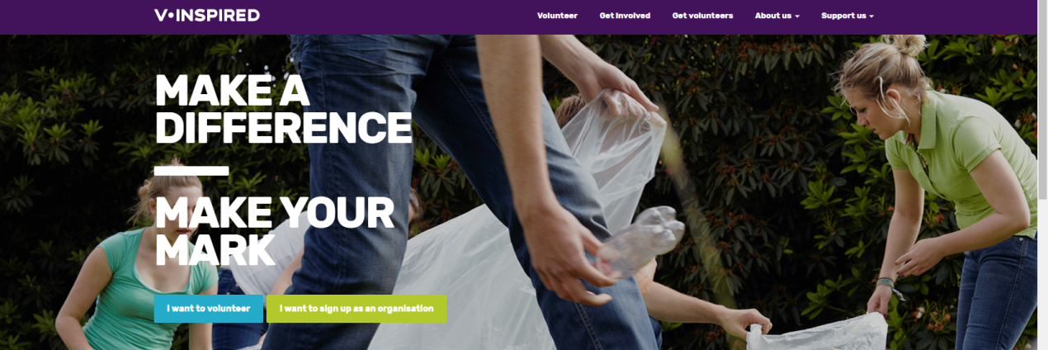
V-inspired
Certificates for 10 hours, 30 hours, 50 hours and 100 hours.
Get recognised for your volunteering work.
Get a volunteering CV and impress colleges, universities and potential employers with your achievements.

Slide 32
Discretionary Bursary Fund
Information enclosed in letter - also available on website.
Guaranteed Bursary - £1200 per year.
Discretionary Bursary – Deadline for applications - 15th October
Payment dependent on full attendance

Slide 33
The Way Forward
Importance of working together
Subject specific information available and Sixth Form Handbook on website
Results Day
- Thursday 17th August 2017

Slide 34
Thank You
We are all really looking forward to working with these young adults over the coming two years
AS/A Levels are challenging, but they are hugely rewarding and open so many doors for young people

