Slide 1

New AQA Spec
For 2015
A Level Psychology
Introduction Summer Project 2016
This research based project is designed to give you an ideal grounding for your A Level Psychology course.
Research and complete the tasks independently over the summer in preparation for Year one of the Psychology A-Level.
Present the tasks in any format you like and bring it with you to your first lesson after the summer.
Good luck and Enjoy ☺
The Psychology Team

Slide 2
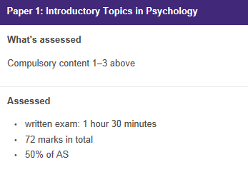
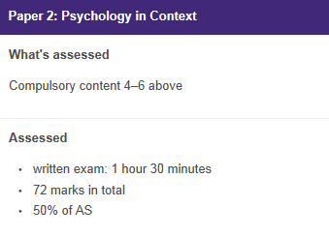
The AQA Course
A Level Year 1
Topics:
Social Influence
Memory
Attachment
Topics:
Research Methods
Psychopathology
Approaches in Psychology (including Bio Psychology)
100% Exam (two papers), 0% Coursework

Slide 3

Task 1, Topic 1: Marvellous Memory…
Mini Experiment:
In this experiment you can test as many or as little people as you like. As the experimenter you should read out one line at a time of the triangle of numbers below to your participant. When you have finished reading out the line, your participant should recite back to you as many of the numbers they can remember. Record how many numbers they recall correctly on each line.
Now think about and explain:
What was the maximum amount of numbers your participants call recall from any line? (If you used more than one participant, take the average).
What do your results suggest about memory?
Now research and answer the following…
What is memory? Does it have different types? If so, explain them…
What is the capacity and duration of the average memory in humans?
What did George Miller do in 1956? What did he discover about memory? How does this link to the results from your experiment above?

Slide 4


Task 2, Topic 3: Social Influence
Obedience, Obey, Conform…
Research and summarise the procedure and findings of ONE of these studies:
1) Milgram’s (1963) Obedience to Authority
2) Zimbardo’s Stanford Prison Experiment
Taking it further…
Explain how the study you chose (Milgram or Zimbardo) might explain historical atrocities such as the Nazi persecution of the Jews…

Slide 5


Task 3, Topic 4: Psychopathology…
What is normal?
Consider, research and explain…
1) Is there such a thing as normal and abnormal? What are the definitions of these?
2) How do Psychologists decide what is abnormal?
Fear. Sadness. Obsession.
Research ONE of the disorders below and note down the symptoms, potential causes and treatments.
Phobias
Depression
OCD

Slide 6

Task 4, Topic 5: Approaches to Psych…
The Famous Five
There are five main Psychological approaches or perspectives. Research them and define each one.
Behaviourist
Psychodynamic
Humanistic
Cognitive
Biological

Slide 7
Task 6, Topic 6: Psychology? A Science? Really?
Now to the biggest and most controversial debate of them all….
Most people assume Psychology is an easy or ‘soft’ subject which cannot possibly be a science. But is it?
It is your job to come to a conclusion as to whether or not Psychology IS a hard science.
Task: Research arguments for and against Psychology as a Science and write down two bullet points on both sides of the table.
Consider:
The Subject Content
Research Methods Used
FOR Psych as a Science ☺ | AGAINST Psych as a Science ☹

Slide 8
Useful Resources & Further Reading
To help you on your way…
Websites:
Youtube have a number of really good factual clips. In particular ‘Crash Course’ have produced a number of introductory videos to key elements in Psychology.
http://www.simplypsychology.org/a-level-psychology.html - Tailored to the old specification, but has all the relevant key information for A Level Psychology.
Books:
Working Memory, Thought and Action – Alan Baddeley
The Lucifer Effect – Phillip Zimbardo
Obedience to Authority – Stanley Milgram
Fundamentals of Cognition – Michael Eysenck
Psychology: The Science of the Mind and Behaviour – Richard Gross
The Complete Companions: AQA Psychology Year 1 and AS Student Book – Mike Cardwell & Cara Flanagan
AQA Psychology for A Level Year 1 and AS Student Book – Cara Flanagan & Dave Berry

