Slide 1
Year 12 Induction Evening for students and parents
1st October 2015

Slide 2
Welcome
The Sixth Form team
Head of Year 12 Richard Hand
Key Stage 5 Leaders Gisella Vignali
Steve Rayner
Sixth Form Manager Chris Bullion
Sixth Form Administrator Sharon Bell
Head of Year 13 Toby Jessop

Slide 3
Aims of the evening
Information on structure and content of AS and A2 courses.
Information on the differences between life at Key Stage 4 and Key Stage 5.
An opportunity to meet the Sixth Form Team.

Slide 4
Aims of the Sixth Form
To work with students and parents to ensure that our young people achieve, not only academically, but also develop the skills and attributes which are essential to success in later life.

Slide 5
Easing the transition to KS5
Our expectations of students
Agreement
Hard work
Study skills/time management
Effective use of study periods
Supervised study

Slide 6
Plan for the future
Prioritise commitments
  Social life
  Part time job
  SCHOOL WORK
  (16 hours per week outside school)
  Sixth Form Centre open from
  7.30am to 5.00pm

Slide 7
Support for Students
KS5 learning mentor guided support during study periods
Liaise with subject staff
Part of monitoring programme

Slide 8
Attendance
Attendance at lessons is not optional
Students’ attendance is checked weekly and dealt with by a series of increasingly serious sanctions.
Persistent offenders will find that their future in the Sixth Form will be under review.
There is an obvious connection between good attendance and doing well

Slide 9
Mentor Meetings
Bridge the gap between KS4 and university/career
These will start in November
Scheduled at mutually convenient times, perhaps before period 1, more often Wednesday or Friday at 2.05 when you have a lesson period 5.
“review progress, discuss future plans and any concerns”

Slide 10
Communication
Key to success at KS5
Talk to us – Sixth Form team, mentors and subject teachers
A Levels and FE are challenging! If you can do it easily, you’re not learning!
Don’t let small issues grow into bigger issues
Persevere

Slide 11
Enrichment Activities
Subject based activities aimed at deepening student’s knowledge and interest in subject.
Competitions, extra reading, attending lectures at local universities, study days
Seek advice from mentors and subject teachers
Work experience

Slide 12
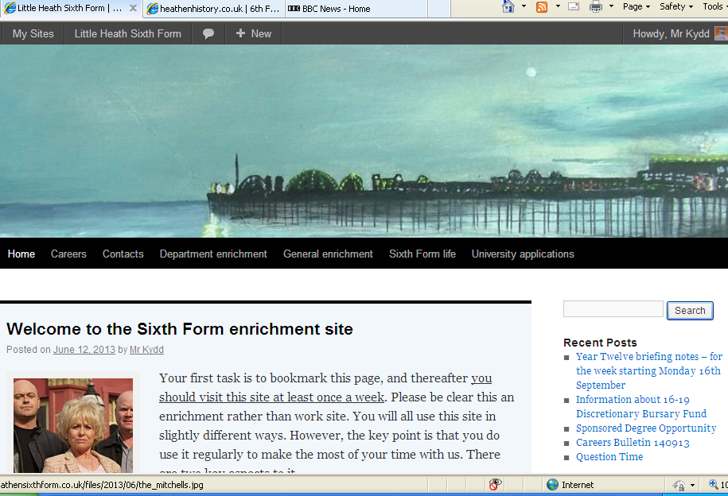

Slide 13
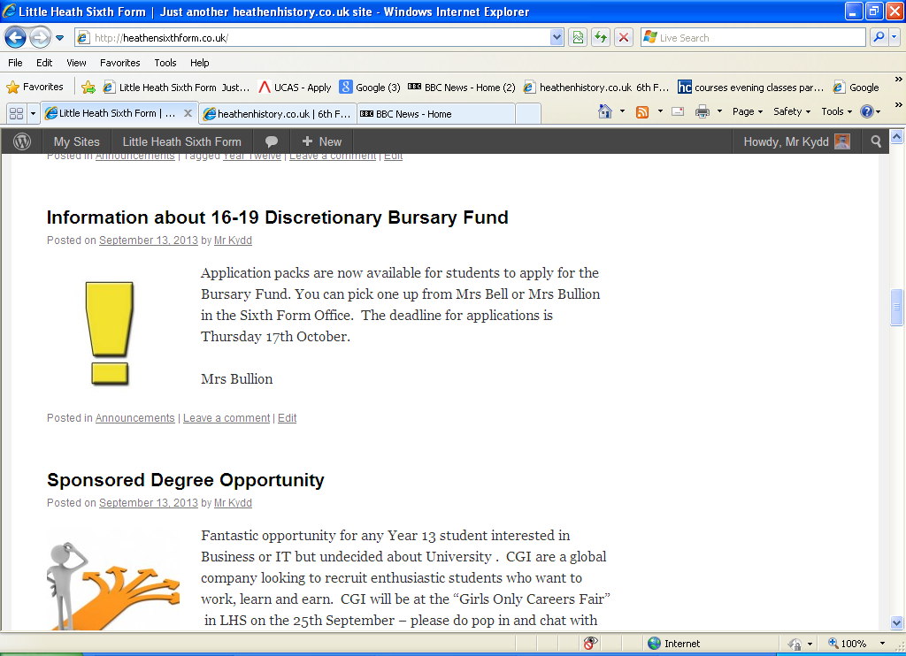
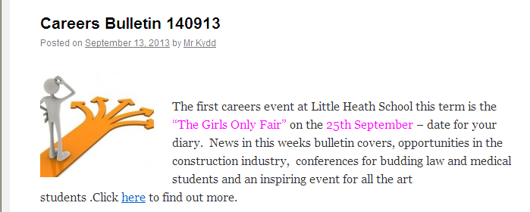
http://heathensixthform.co.uk/

Slide 14
Personal Learning Checklists (PLCs)
Developed by departments in all subjects at AS and A Level.
Student friendly checklist of knowledge and skills they will need to succeed in their subjects.
Students should be checking their progress against these regularly.
Available on heathensixthform website
Independent learning

Slide 15
New Sixth Form Centre
Open in November
State of the art facilities
Sixth Form Library
Dedicated study areas
Seminar rooms
Wi-Fi
A real hub of learning
A 21st Century Sixth Form Centre – about time too!

Slide 16
The Curriculum
Broad curriculum on offer:
Mixture of new linear and modular A Levels
4 AS in Year 12
3 or 4 A levels in Year 13 + EPQ
Opportunity to study a wide variety of courses.
Opportunities to re-sit GCSE Mathematics and English

Slide 17
Assessment
Students are taking either Modular or Linear AS/A levels
A mix & match set up this year, with two systems running
The other 15 subjects are still modular
11 subjects Linear from Sept 2015
Art | English Literature
Biology | Economics
Business | History
Chemistry | Physics
Computing | Psychology
English Language
.

Slide 18
Assessment
Modular A Levels
Students study 2 or 3 units in each of their AS subjects.( Most A levels are made up of 4 units)
The marks achieved in these units contribute to half their final A Level grade.
An AS is a separate qualification but it’s also half of A level
BTEC assessment 6 units – mostly coursework
.

Slide 19
Assessment
Linear A Levels
Students study 2 or 3 units in each of their AS subjects.( Most A levels are made up of 4 units)
Students will sit AS examinations in May/June
However, these marks do not contribute to the final grade, this is based on all marks achieved in the final examinations at the end of Year 13.

Slide 20
Assessment
MODULAR or LINEAR:
Doing very well at AS level, regardless of whether you are taking Linear or Modular courses, is very important.
AS results will be a very good indicator of the progress students are making towards a great set of A level grades.
They are the ‘gateway to success’ in Year 13.
Make the most of every opportunity offered by subjects and teachers this year and use time in school and at home wisely – especially study lessons!

Slide 21
Assessment
PPEs – Pre-Public Examinations:
The PPEs (Mock exams) will be held in January – in lesson times.
Year 12 Report sent home around February half term
Year 12 Parents’ Evening
– Thursday 25th February 2016

Slide 22
Getting coursework right
Assessment objective of some KS5 subjects but crucial to success in Applied A levels
Applied A levels - coursework accounts for two thirds of the final mark.
Essential to break up tasks and plan time effectively so that deadline is met and final product is the best piece of work a student can produce.
Deadlines in pack – look out for pinch points.

Slide 23
Target Setting - Aiming high
At the start of Year 12 all students are given minimum target grades [MTG] based on how well they did at GCSE
We ask students to think beyond these and set themselves target grades which include some challenge and be aspirational.
Planning and researching future career paths is integral to this process.

Slide 24
Why we discourage students dropping subjects at AS
Students with an average GCSE performance of C nationally
Number of AS subjects taken | 2 | 3 | 4
Number of students | 1391 | 3346 | 1111
Average grade per subject | DD | CCD | CCCC

Slide 25
Opportunities to discuss progress
Y12 Introductory Mentor Meeting – Wednesday 18th November
Parents evening with subject teachers - Thursday 25th February 2016

Slide 26
Developing the whole student
Increasingly crucial to success in application for the next step in education/training
Wide range on offer
House captains
Voluntary service in the community
Sixth Form Committee
Sixth Form Student Voice – School Council
Student Duty Team
Competitions

Slide 27
The PiXL Edge is a framework for schools to develop and accredit in students those personal attributes essential for employability and life.
Notes:
Insert a slide after this which has the animation

Slide 28
THE EDGE: aims & objectives
To provide a framework for students to demonstrate five key skills:
  Leadership
  Organisation
  Initiative
  Resilience
  Communication
To support students in developing and evidencing these skills.
To deliver a programme that supports a student centred environment.

Slide 29
How have PixL done this?
Establish an approved activity database
Create a secure on-line app
3 levels – PiXL Apprentice, Graduate, Masters
Lead using RSL Edge, HoYs and Tutors
Share ideas & activities with 1000+ schools
Notes:
Delete this slide

Slide 30
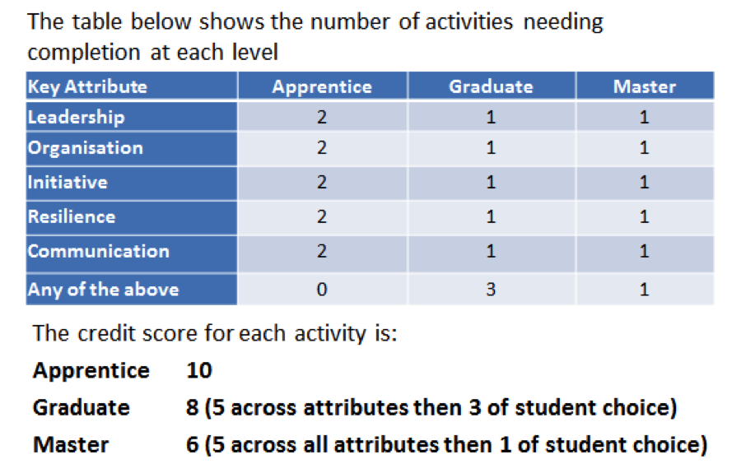
Accreditation

Slide 31
Discretionary Bursary Fund
Replacement for EMA
Information enclosed in letter - also available on website.
Guaranteed Bursary - £1200 per year.
Discretionary Bursary – Deadline for applications - 15th October
Payment dependent on full attendance

Slide 32
The Way Forward
Importance of working together
Subject specific information available
Results Day
- Thursday 18th August 2016

Slide 33
Thank You
We are all really looking forward to working with our young adults over the coming two years
We are especially excited about the New 6th Form Centre
AS/A levels are challenging, but also rewarding and interesting. The best two years of a student’s school career.

