Slide 1
Little Heath School Work Experience 4th February 2019 for one week (Mon-Fri)

Slide 2
Who are we and what do we do?
Education Business Partnership
Work related skills programmes and Careers Inspiration Activities
Work Experience Placements
Active network of 1500 businesses
Over 1200 students involved in work related learning activities in the 2017-18 academic year
- with the aim of inspiring the future work force ….. You !

Slide 3
Why do Work Experience……?
New opportunities – change in routine, new people
Gain an understanding of a particular type of career or of work in general
Gain an understanding of the type of work you do not want to do!
Employability skills
Apply what you are learning in the classroom into work situation
Discovery of new skills and interests
Valuable experience for when writing your Personal Statement, application forms, giving real life examples at interviews
Contacts for the future and possible work opportunities

Slide 4
The UCAS blog suggests that two thirds of employers look for graduates with work experience and one third of employers felt applicants didn’t have a satisfactory level of knowledge of their chosen career
Research undertaken by the Education and Employers Taskforce Charity found that those who did work placements while at school earned an average of £900 per year more by their early twenties than those who didn't take on work experience

Slide 5
Finding your own work experience placement
Consider what you would like to do, sectors and business you are interested in
What interests you? What would you like to learn more about?
Consider who you know who could provide work experience
Consider how you will get there
When you have found a placement:
Employer completes an Own Placement Form and you return it to school
Signatures are required as confirmation from Parents/Guardians, employer and student
EBP will undertake Pre Placement Checks

Slide 6
If you can’t find your own work experience placement
Tell EBP what you would like to do by completing an Application Form:
- Interests
- Three sectors
- Locations / where you can get to and how
- Medical information
Return form to school
Signatures are required as confirmation from Parents/Guardians,
EBP will source a placement for you and undertake Pre Placement Checks

Slide 7
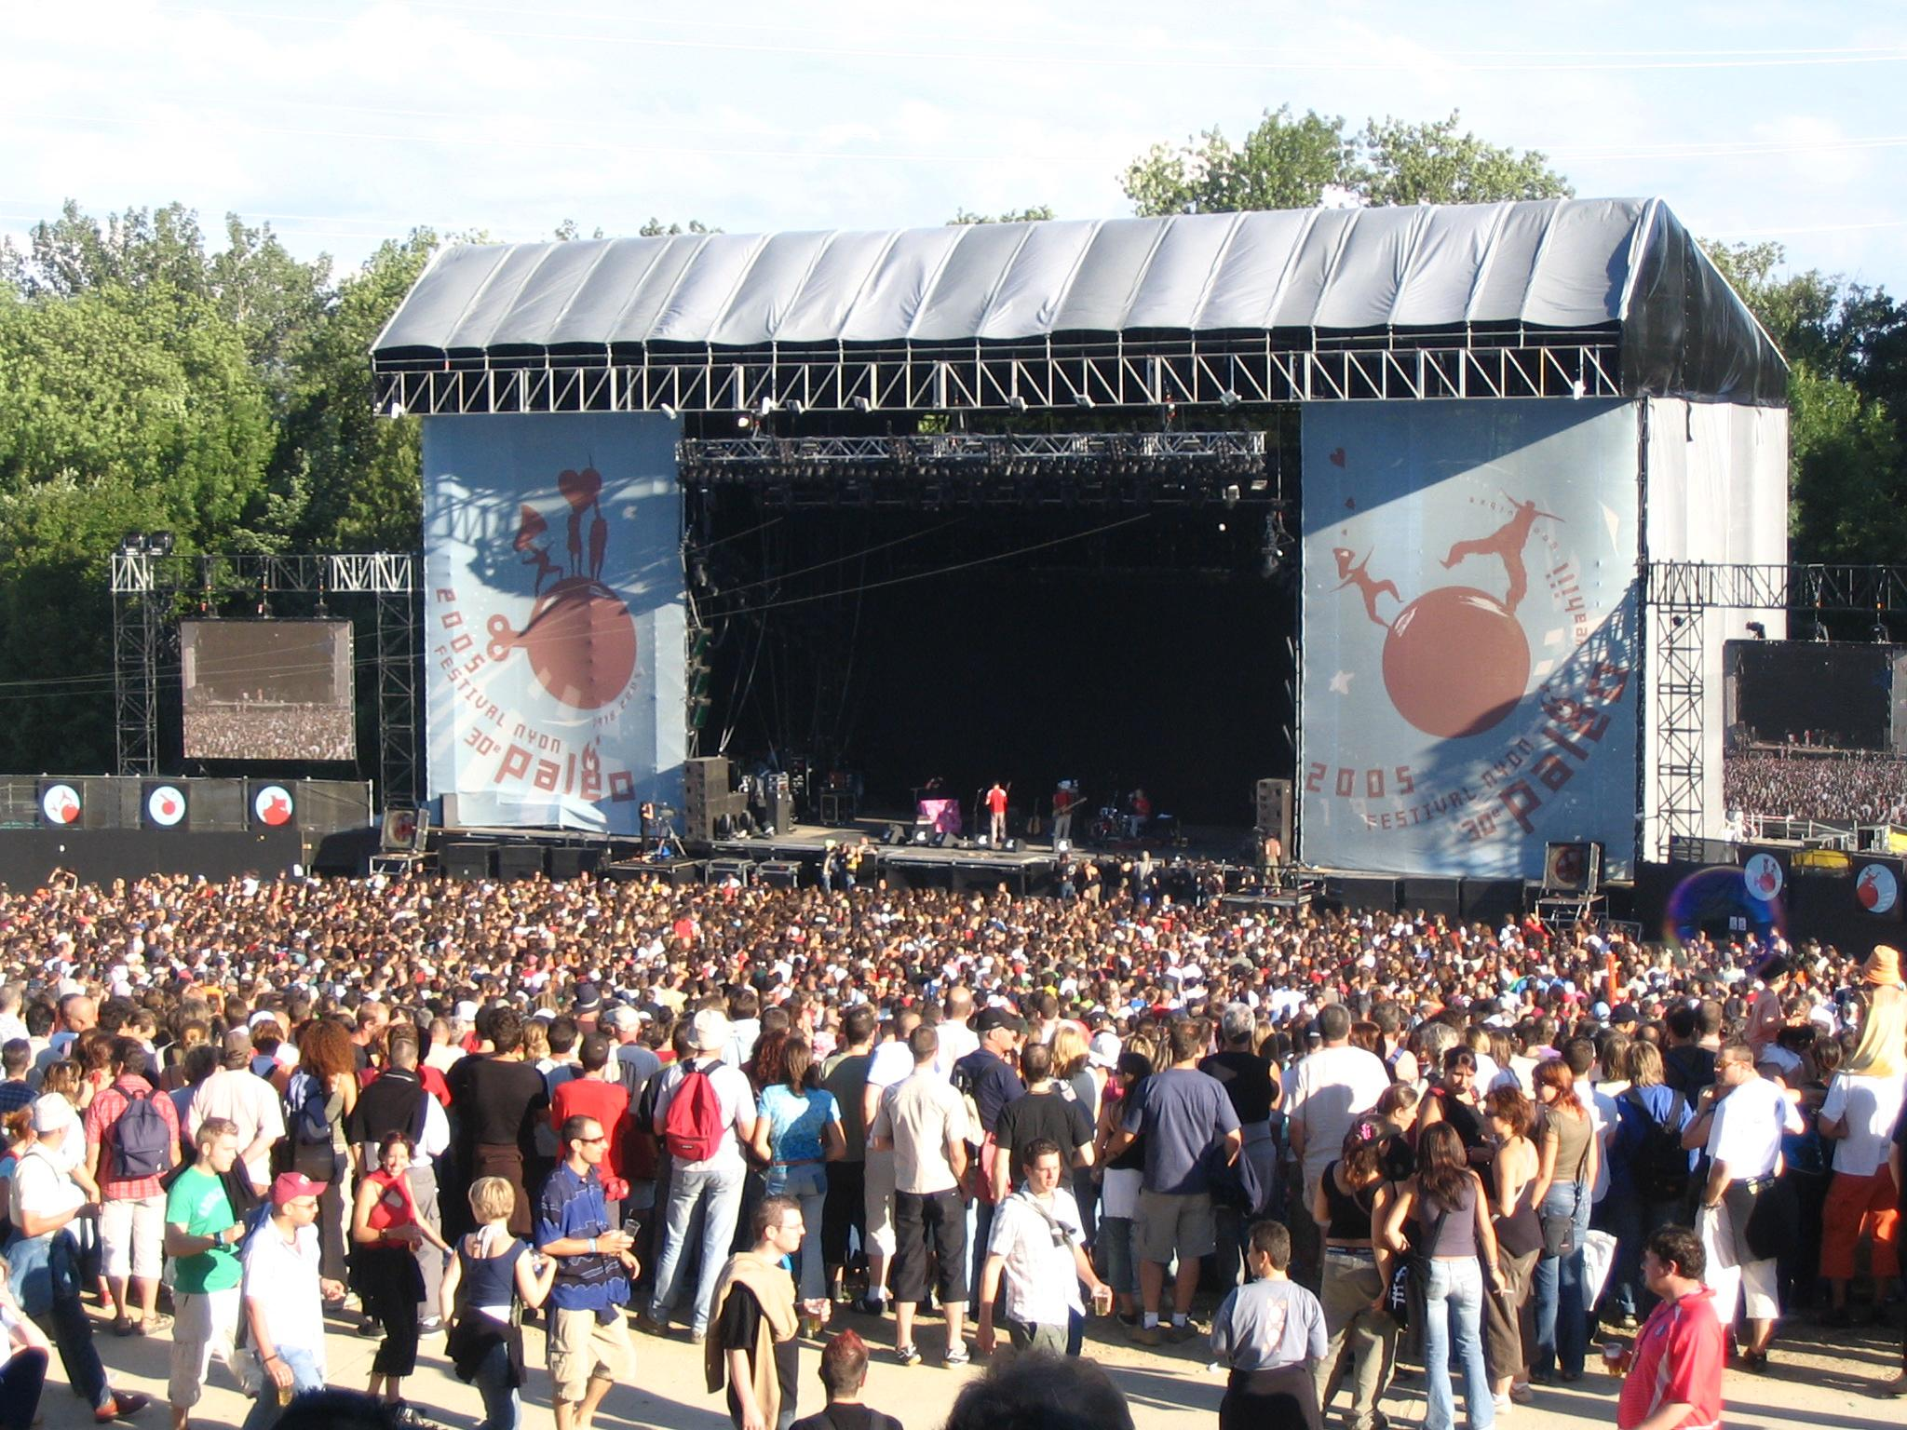
Costs
Own Placements
These cost £40
Yes there is a cost but how much would you spend in these situations and what value could this add to your future?
EBP sourced Placements
These cost £77

Slide 8
Planning and Preparation
EBP interview some students for individual placing
Students issued with a job description
Parental consent forms
Make and maintain contact with your employer prior to start - especially if an own placement
EBP pre placement checks

Slide 9
Students Comments
“It was more tiring than school but at least I didn’t have any homework to do”
“You had to concentrate all the time as you are involved with real customers”
“It was extremely helpful and inspiring, I learnt a lot from the week and would highly recommend it to anyone else.”

Slide 10
Employers Comments
“. . he was quiet at first, but not for long!”
“The student was exemplary. She was hard working, able to use her initiative, demonstrated a positive attitude and was happy to do all tasks that were asked of her.”
“She was a joy to have in our office!”

Slide 11
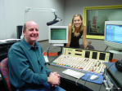
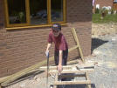
Any Questions ?

Slide 12
Support to find your own placement
Talk to family and friends and explore ideas
Your mentor can discuss ideas with you
Mrs Wooller (ewooller@littleheath.org.uk)
Mr Male (amale@littleheath.org.uk)
Careers fair 17.10.18. 6-7.30pm HERE!
Look online, write a letter, make a phone call. If you don’t try, you’ll never know!

Slide 13
Dates and Deadlines
24.09.18. Parent information Evening, Main hall, 6.30-7.30pm
30.10.18. Hand in Own Placement or EBP application form to Sixth Form Reception (or before if ready!)
14.01.19. Health and Safety briefing in assembly and final Placement Forms issued
Parental consent form signed and returned to Sixth form Reception by 21.01.19.

