Slide 1
University of Reading Library
Getting the most out of your visit
Ruth Gooding
r.gooding@reading.ac.uk

Slide 2
What we’re going to cover
Introducing the Library
Findings books and
other items
Online resources
Visiting the Library

Slide 3
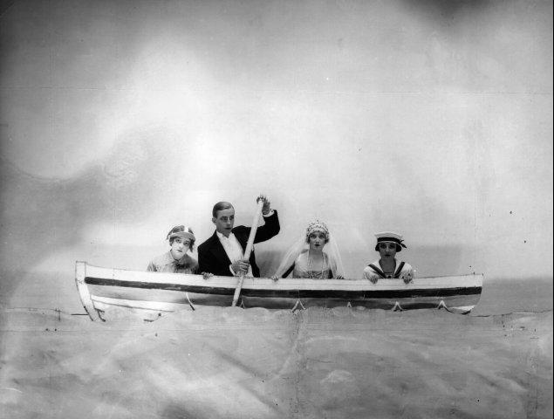
Your experiences
Have you used such a large library before?
What did you think when you entered the building?
© Getty Images (Education Image Gallery)

Slide 4
Using a library = easy as ABC
Many students are intimidated when they first come to university
They are unfamiliar with using such a big library
Often have no idea what they should read, when they should read it, or how to find it
Once you have the basics, life gets easier
Key = Don’t Panic!

Slide 5
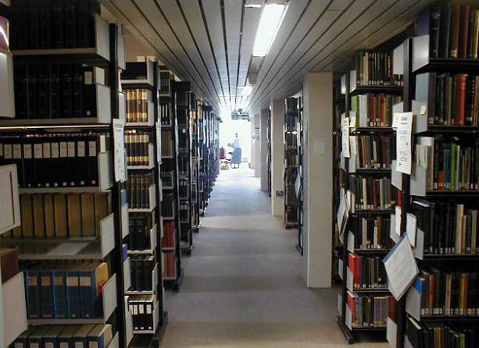
Over 1 million volumes

Slide 6
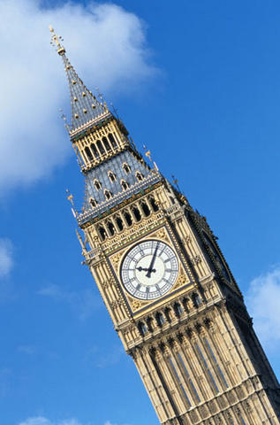
Facts and figures
The number of visits made to the Library each year is equivalent to over eleven sell-out audiences at the Millennium Stadium, Cardiff.
If stacked up, the amount of books added to the Library each year would measure three times the height of Big Ben.
© Getty Images (Education Image Gallery)

Slide 7
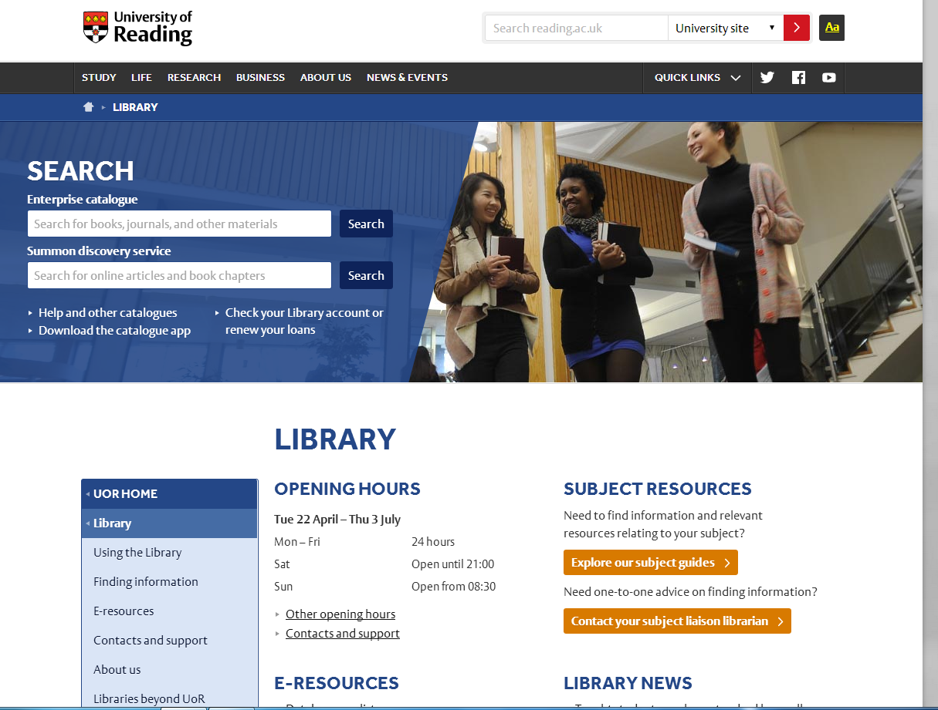
Library website

Slide 8
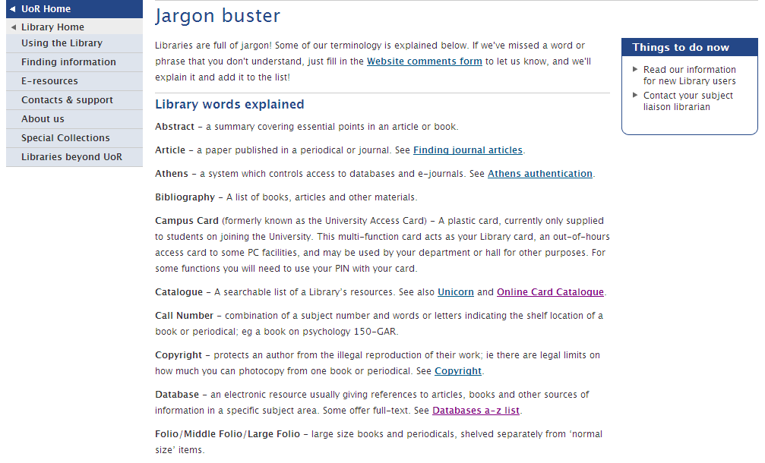

Slide 9


Why use the Library?
Primary texts – books and online
Criticism and secondary reading
  Engage with scholarly debate, keep up-to-date
A place to work
  Spaces for individual or group study
Materials for leisure time
Quality alternative to Google and Wikipedia

Slide 10

Books
Subject floors
  Science and Technology – 2nd Floor
  Arts and Humanities – 3rd Floor
  Social Sciences (incl. History and Law) – 4th Floor
Size
  Normal
  Folio (large)
Reference section – books that cannot be borrowed

Slide 11
Finding the item you want
Browsing is OK in small libraries
Not an efficient strategy for finding a specific item, especially in a large library
Enterprise, the Library catalogue, tells you exactly where to look for an item
Tells you if someone has already borrowed it

Slide 12
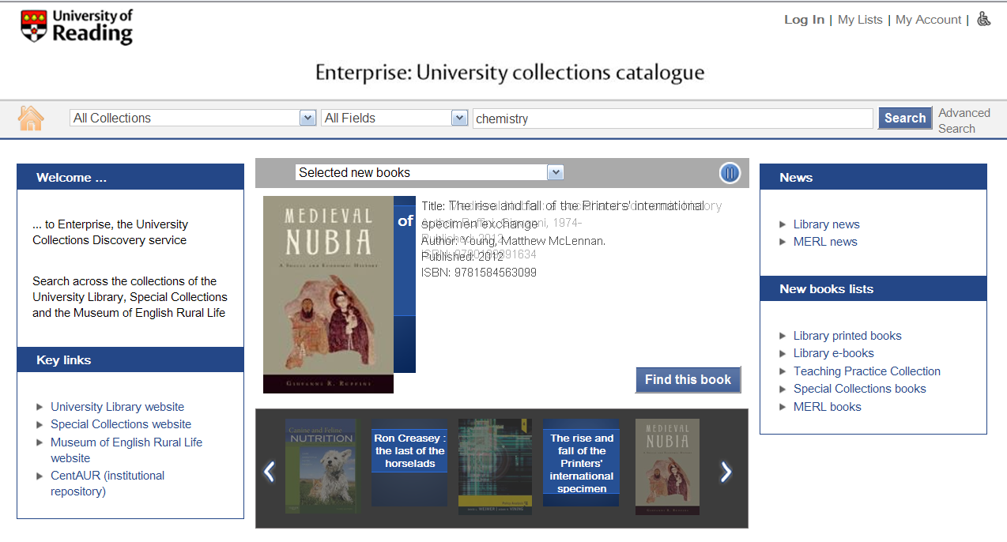

Slide 13
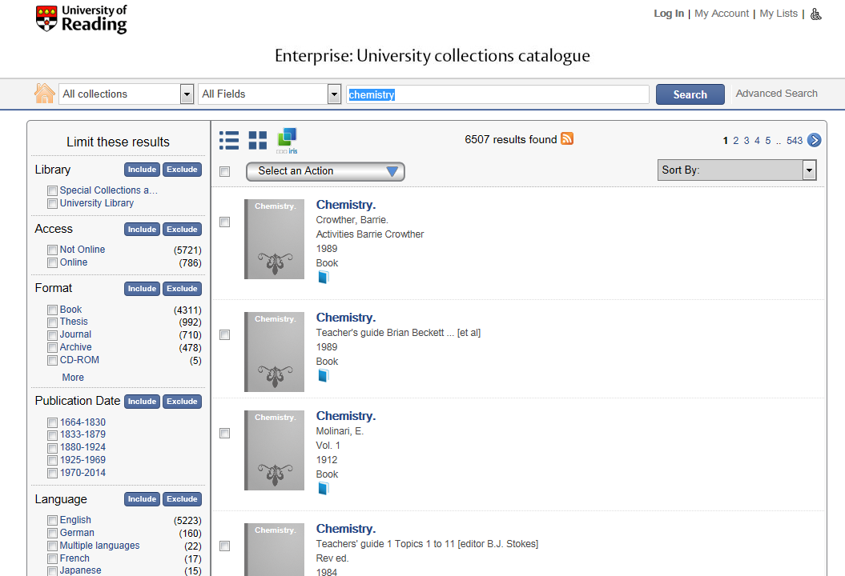

Slide 14
Searching…
Think carefully about your topic before you start
Think of similar words so that you do not exclude useful results
Try other words if you are not finding things first time
Don’t forget to use the contents and index of books to trace answers!

Slide 15
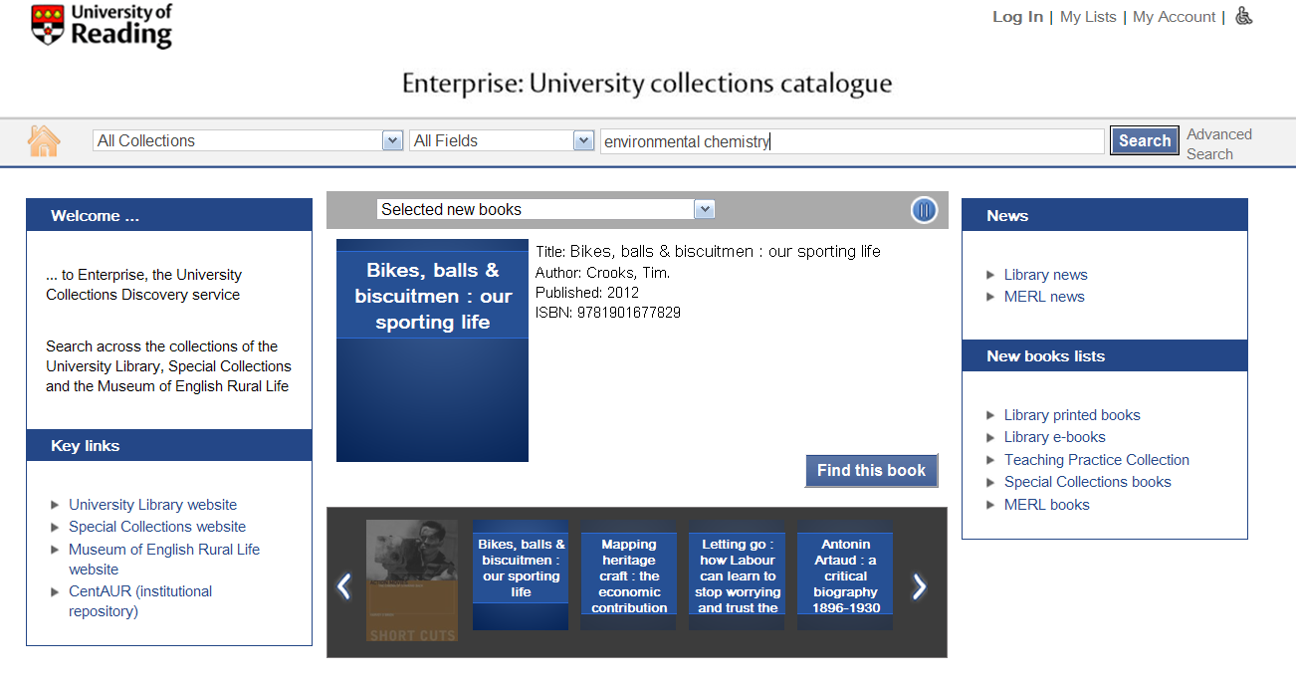
Add more keywords…

Slide 16
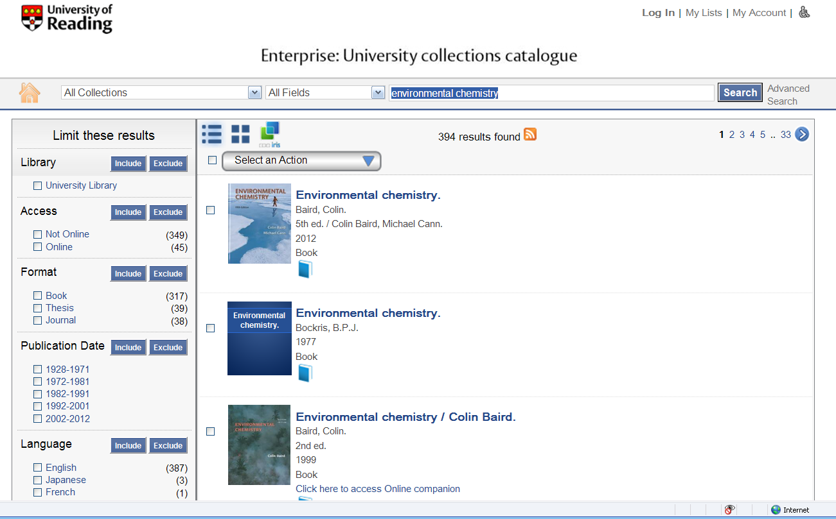
Results screen

Slide 17
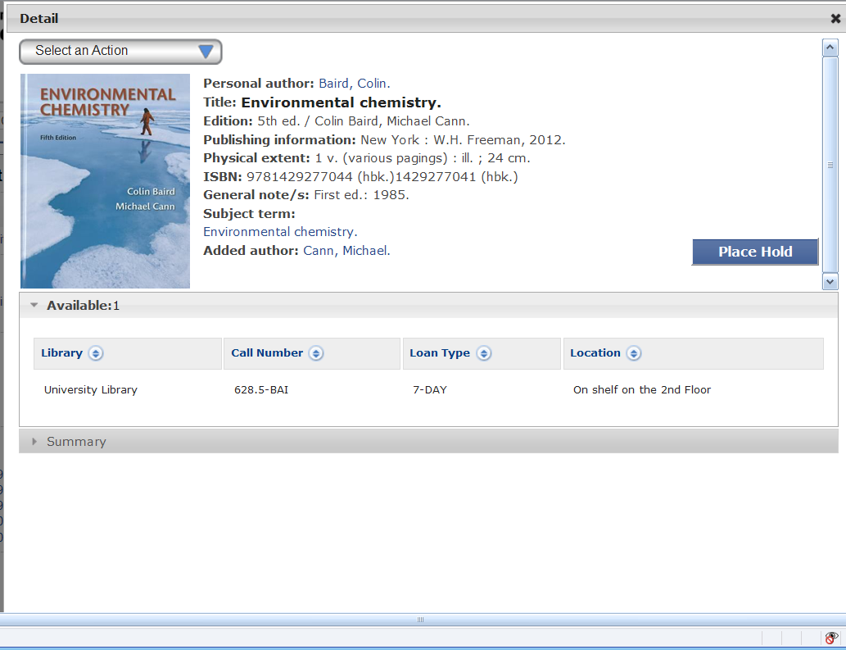
A typical record

Slide 18
Call numbers consist of:
A prefix eg Periodical, Folio
A classification number eg 574.5222
An author mark: the first three letters of the author’s surname eg PUL
eg FOLIO--574.5222-PUL

Slide 19
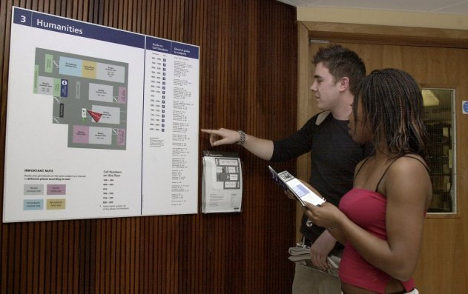
Locating items

Slide 20
Reference section
Quick access to factual information
Good for definitions, brief historical information, biographies etc
e.g. Penguin Dictionary of Geography, Encyclopedia of Religion, Oxford Concise Medical Dictionary, Dictionary of National Biography
Example call number: 2ND FLOOR REFERENCE--610.3-CON

Slide 21
Not just printed books
Journals – print and electronic
E-books
  Electronic versions of key texts
  Links on the Enterprise catalogue
Documents on web sites
Other sources (films etc…)

Slide 22
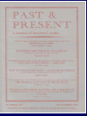

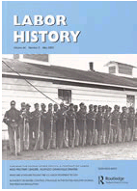

Journals or periodicals
Scholarly magazines
General, specific
Monthly, quarterly, annually

Slide 23
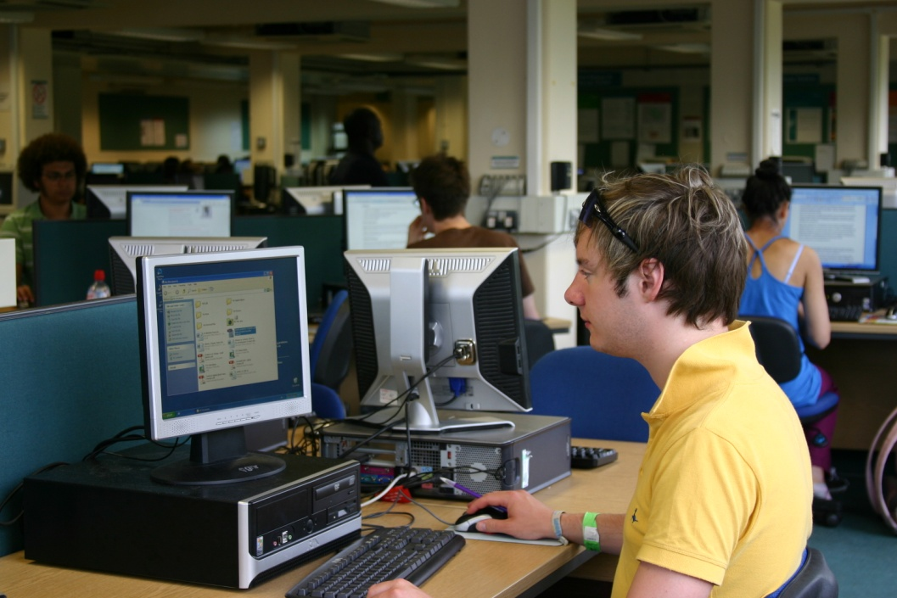
Electronic journals
Many electronic versions of journals
Links from Enterprise record
Not all titles available electronically

Slide 24
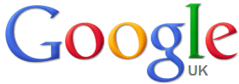
Why not just use Google?
Google does have its uses!
However, Google does not discriminate – anyone can make a website eg Holocaust denial websites
It doesn’t find everything and prioritises results
Evaluate the web resources you use
  Who wrote them?
  When were they last updated?

Slide 25
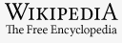
Or Wikipedia?
Wikipedia is also useful- but with caution! DO NOT quote it in your assignments
Anyone can edit Wikipedia,
and there are errors
There are lots of better sources for academic work and referencing
  Oxford Dictionary of National Biography
  Victoria County History

Slide 26

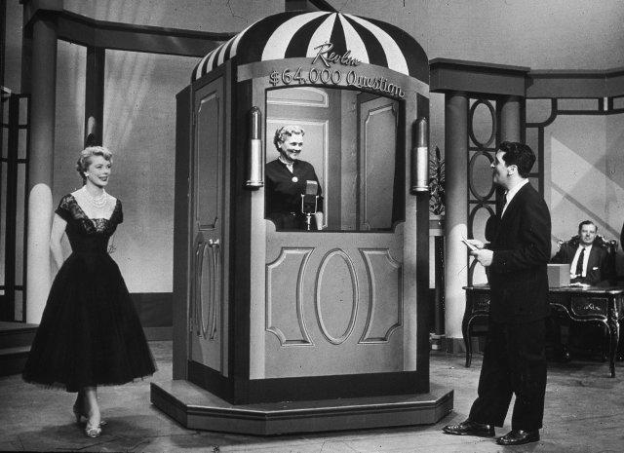
Wikipedia
© Getty Images (Education Image Gallery)
Wikipedia
Library

Slide 27
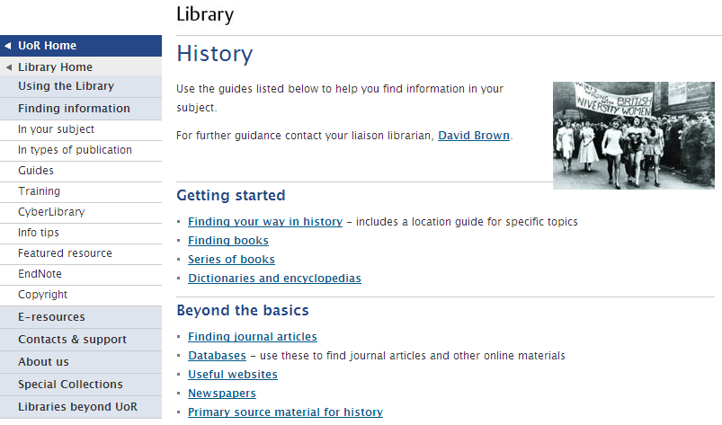
History subject guide

Slide 28
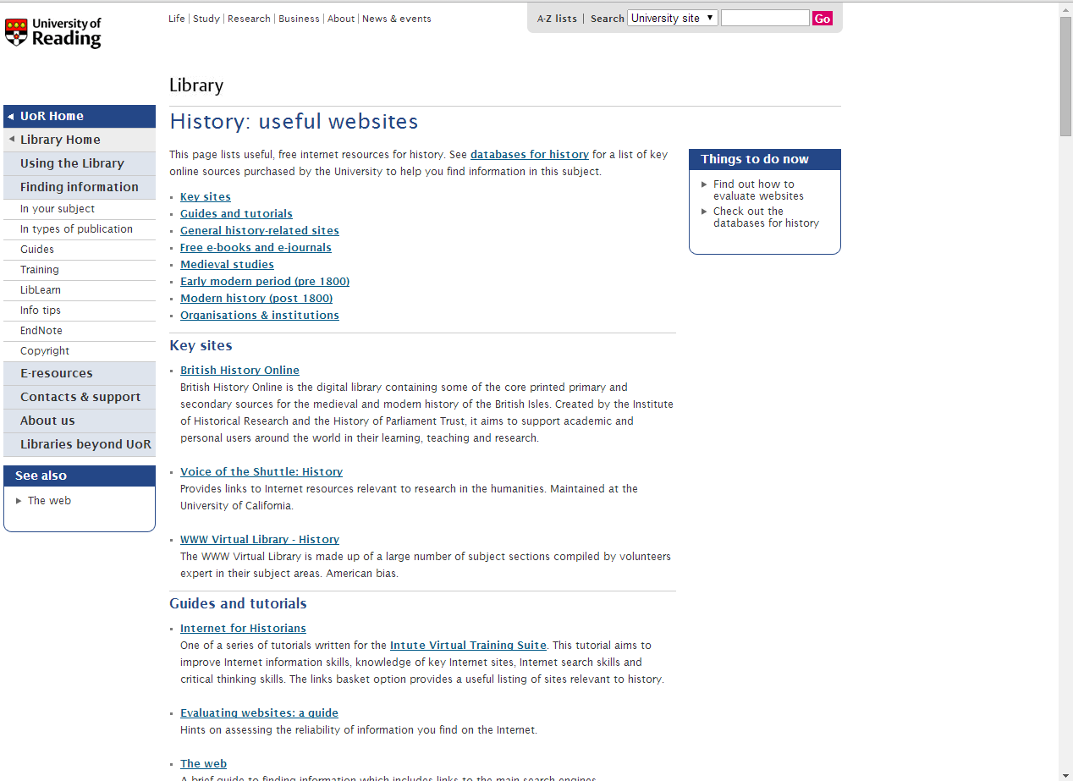
Useful Internet resources

Slide 29
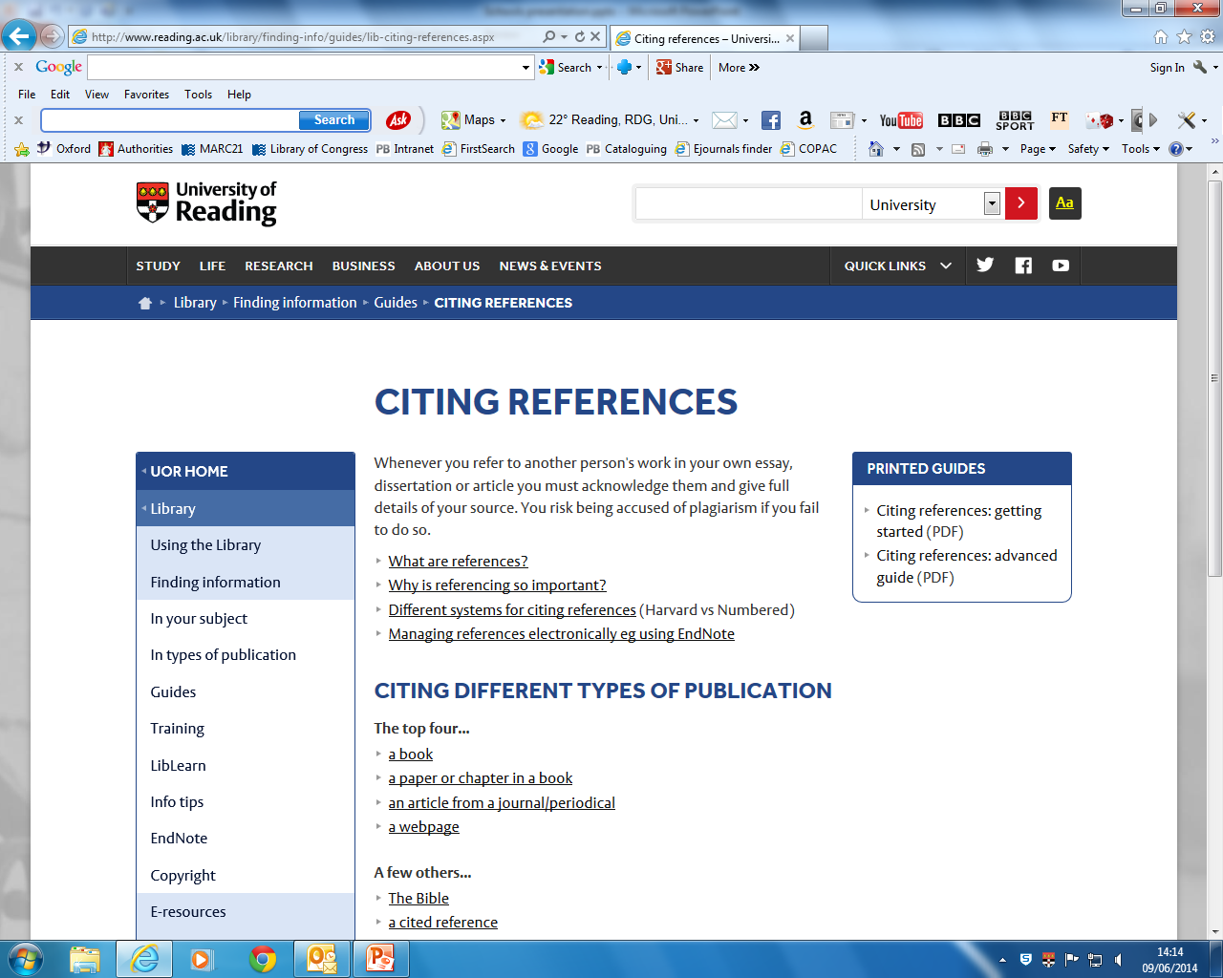
Citing references

Slide 30
Visiting the Library
Library is open to individual students
  Email me in advance if you want to visit
Sign in using the Visitors Book at the Reception desk on the Ground Floor
Reference only access to books and printed journals
Remember: the Library can get very busy – no access during exam periods
  Plan your visit to avoid peak times

Slide 31
Library opening times
Term-time
Monday-Friday
24 hours
Saturday
Open until 21.00
Sunday
Open at 8.30
Summer Vacation
Monday-Friday
08.30-17.00
Saturday
Closed
Sunday Closed

Slide 32


Rules and regulations
Use Library items
Seek help from Library staff
Treat materials and staff with respect
Do not use your mobile phone
Do not eat or drink in the library (except bottled water)
Do not write in library books

Slide 33
True or false?
Enterprise will tell you which floor to find the book you need.
Adding extra keywords to your search will give you fewer results.
If you spell a word incorrectly, Enterprise automatically corrects your spelling.
A Folio book is larger than a normal size item.
TRUE
TRUE
FALSE
TRUE

Slide 34
True or false?
FALSE
All journals are available electronically.
Google generates results selected by experts in the subject.
School students can visit the Library for reference use.
FALSE
TRUE

Slide 35
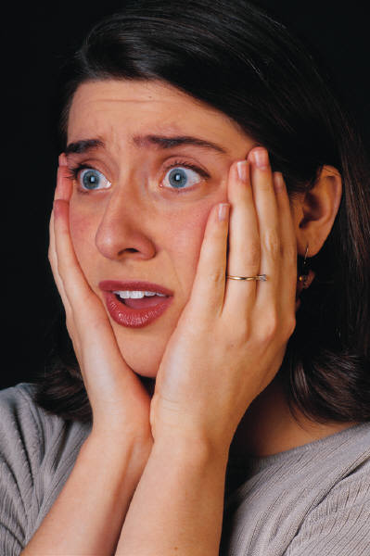

Summary

Slide 36

Summary
The University Library is very big
  Locate useful books using Enterprise
  Use the maps and floor plans to find your way around
Understand call numbers and how to find them
Explore the Library website
Use the Library for your studies

Slide 37

Any Questions?

