Slide 1
Visiting the UoR Library
Ruth Gooding

Slide 2
Session outline
Introduction
What can you expect from a visit to University of Reading Library
What might pupils need to know e.g. how to use the catalogue
Other resources pupils can use

Slide 3
1
Visiting the Library
2
Finding and evaluating information
3
Resources outside UoR Library

Slide 4
1
Visiting the Library

Slide 5
Types of visit
Widening participation
  Traditional style of visit
  Often in conjunction with academic departments or Student Outreach and Recruitment
Using Library resources
  International Baccalaureate and Extended Project Qualification
  Require searching for information and applying critical thinking

Slide 6
Visiting the Library
University vacation periods or after the Summer exam period – Building work this Summer
No access during exams
Pupils must be accompanied by staff and abide by the Library code of conduct
Subject specific visits are arranged with the appropriate subject liaison librarian
  Involvement depends on level of time they feel they can offer
No borrowing rights or access to electronic resources

Slide 7
2
Finding and evaluating information

Slide 8
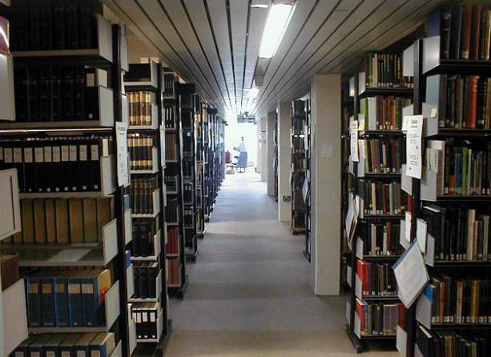
Finding information -
Library resources
Over 1 million items in the
Library
Print books and journals
Browsing is not always an
efficient strategy to find
books
Students need to be able to use the Library catalogue Enterprise

Slide 9
Using Enterprise
Demonstration
Searching options
Print or electronic item
Full record / More information

Slide 10
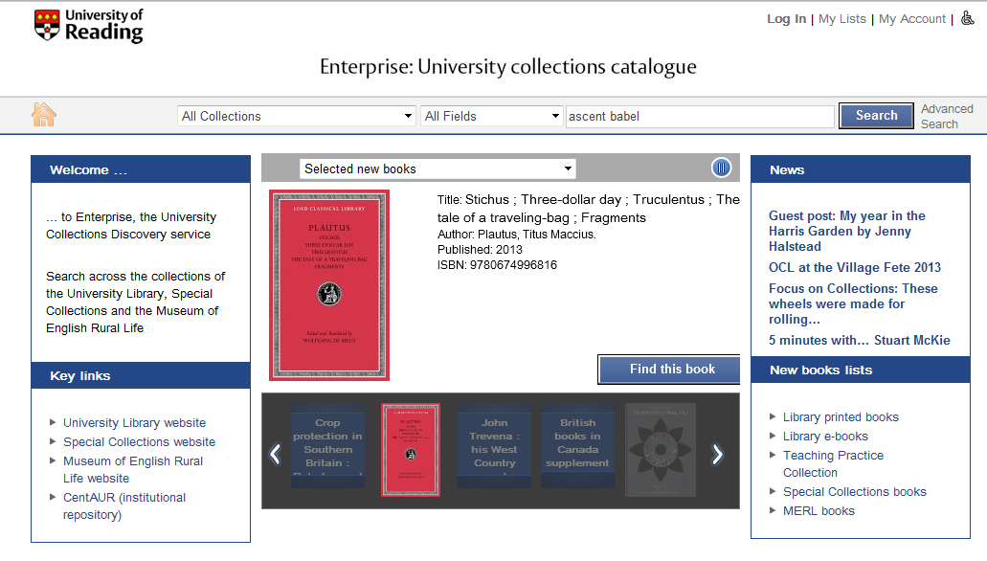

Slide 11
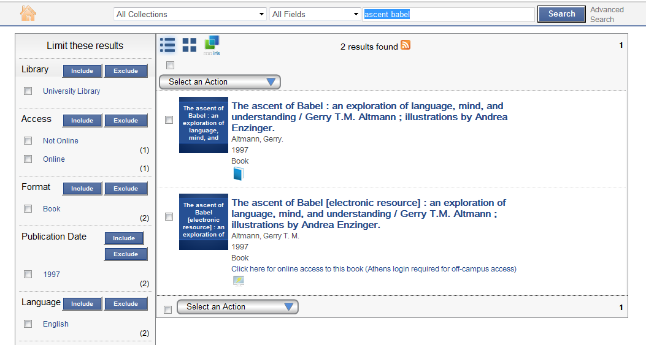
Search results

Slide 12
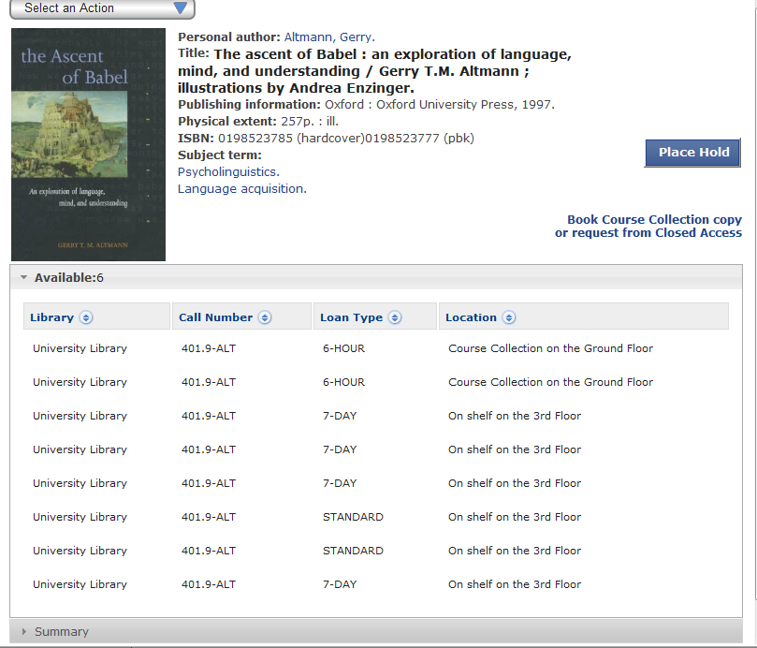

Slide 13
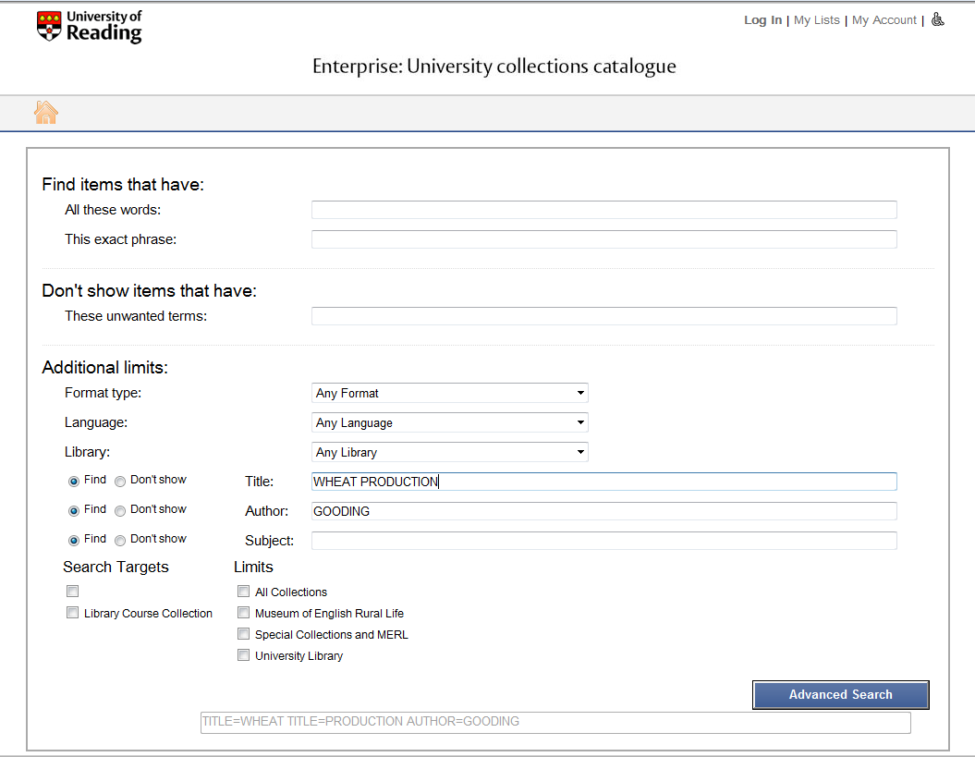

Slide 14
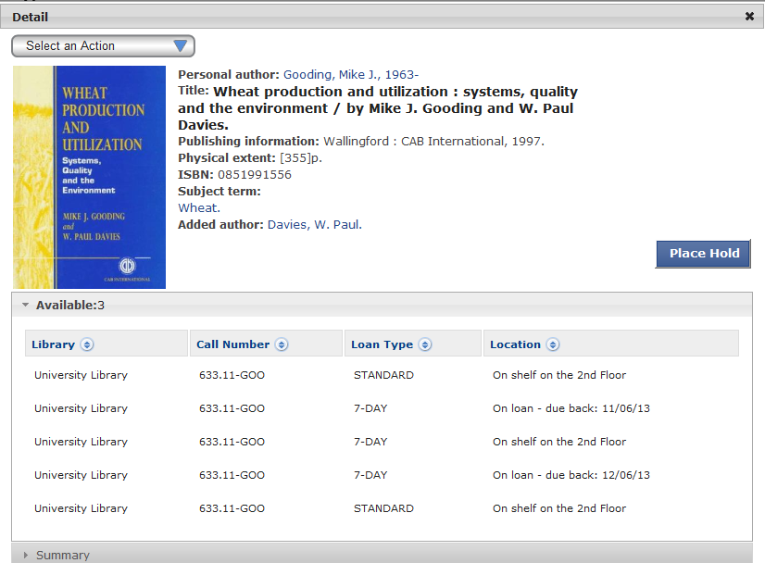

Slide 15
Call Numbers are usually made up of:
A prefix eg Periodical, Folio
A classification number eg 401.9
An author mark: the first three letters of the author’s name
eg 401.9-ALT

Slide 16
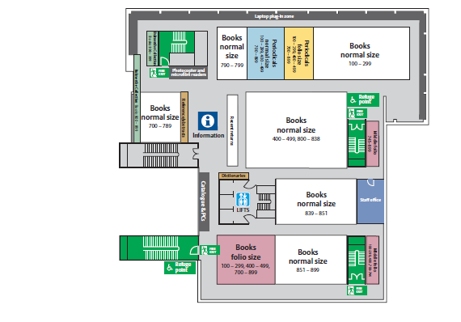
Floor plan
401.9

Slide 17
Dewey Decimal resources
Different libraries may use different classification schemes
OCLC guide to understanding Dewey Decimal Classification
Help on the Library website
  Floor plans
  Audio tours

Slide 18
Evaluating information
“Information literacy is knowing when and why you need information, where to find it, and how to evaluate, use and communicate it in an ethical manner”
  http://www.cilip.org.uk/get-involved/advocacy/learning/information-literacy/Pages/definition.aspx
Plan searches before using Enterprise

Slide 19
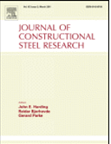
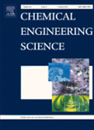
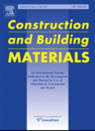
Planning search strategies
Level of information
  Undergraduate textbooks
  Journal titles beginning Progress in... or Advances in...
Constructing a search
  Search terms?
  Date range?
  Author?
  Geographical limits?

Slide 20
Evaluating material
Evaluate the content and the source of the material
  Popular magazine?
  Website?
Things to consider:
  Author
  Bias in the piece
  Structure of the information
  Spelling and grammar

Slide 21
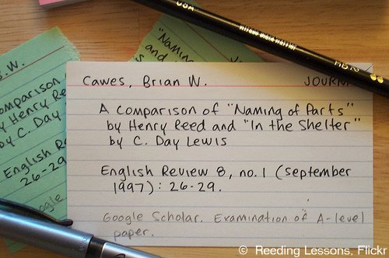
Referencing
Different styles
Library website
  Referencing guides
  Harvard and Vancouver styles
Plagiarism
Tips!
  Keep records of materials cited
  Write down page numbers (for quotations)
  When photocopying mark the sources on the copy
  Be consistent!

Slide 22
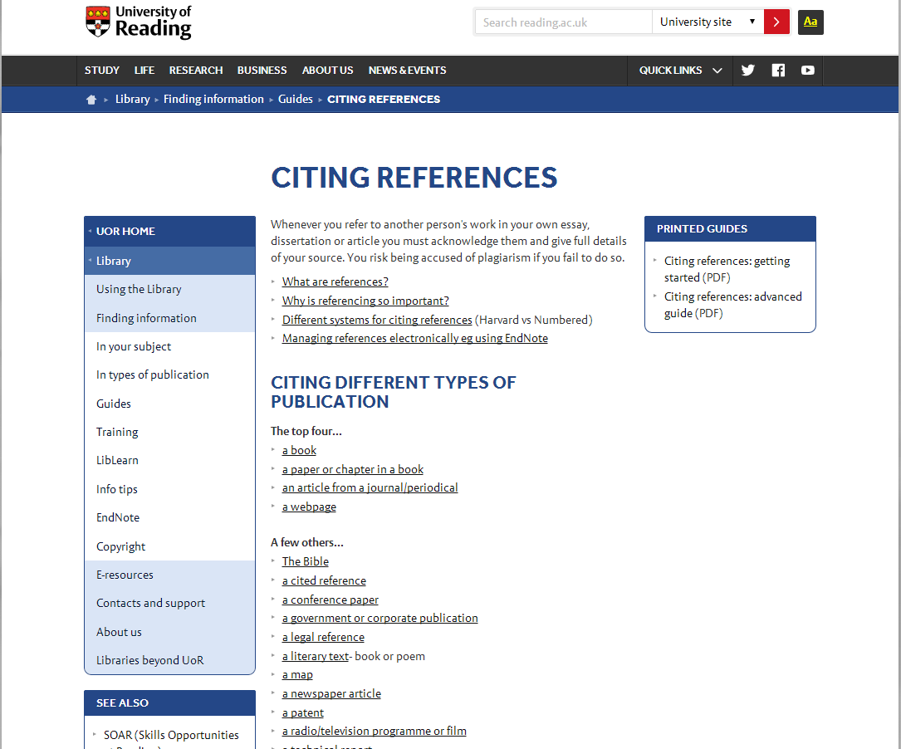
Citing references

Slide 23
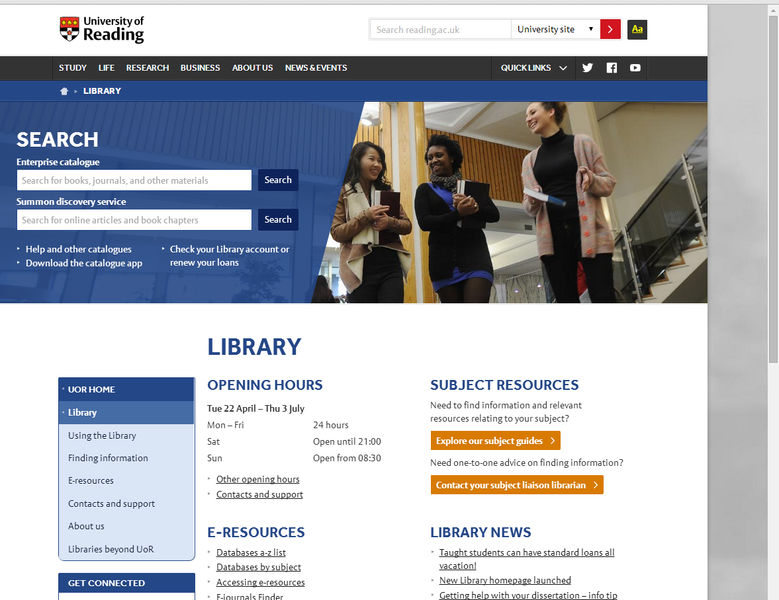

Slide 24
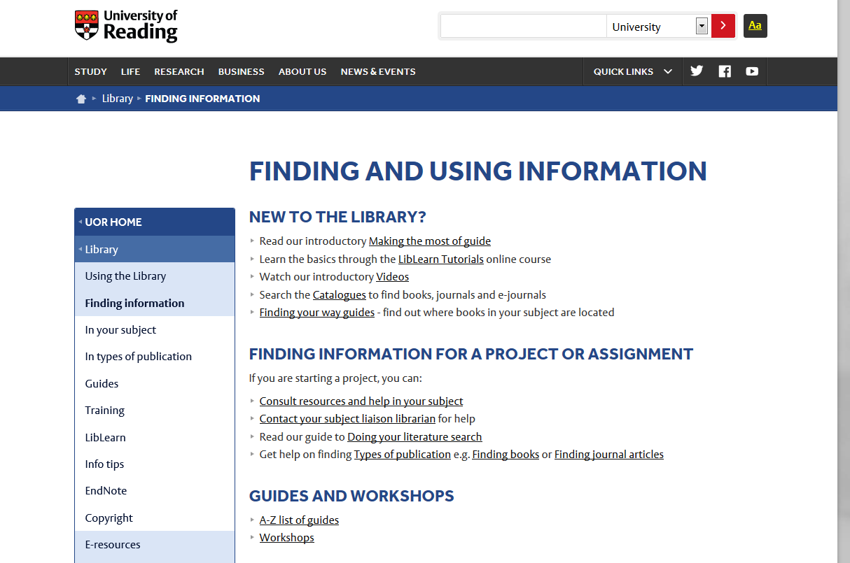

Slide 25
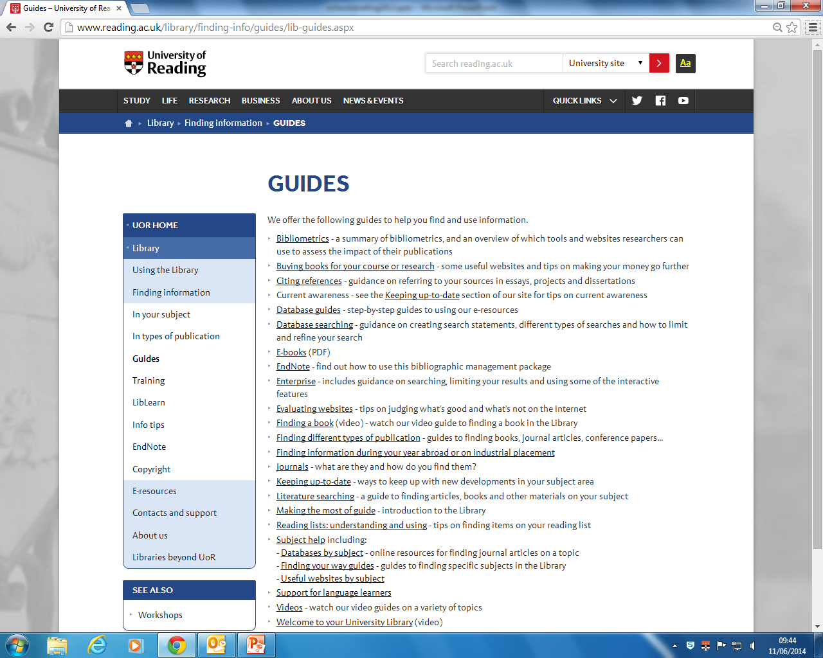

Slide 26
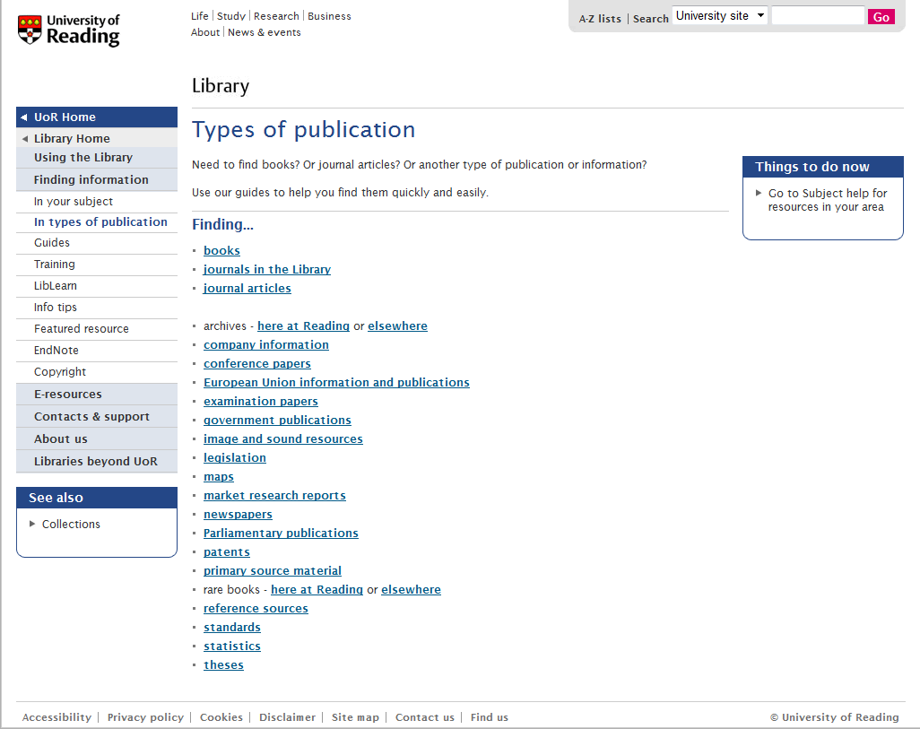

Slide 27
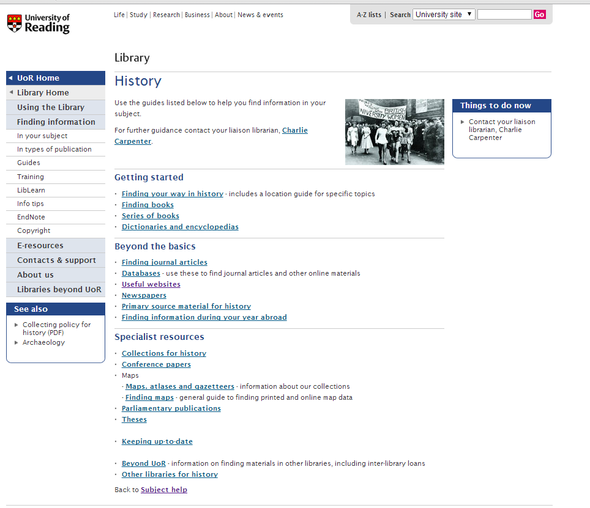

Slide 28
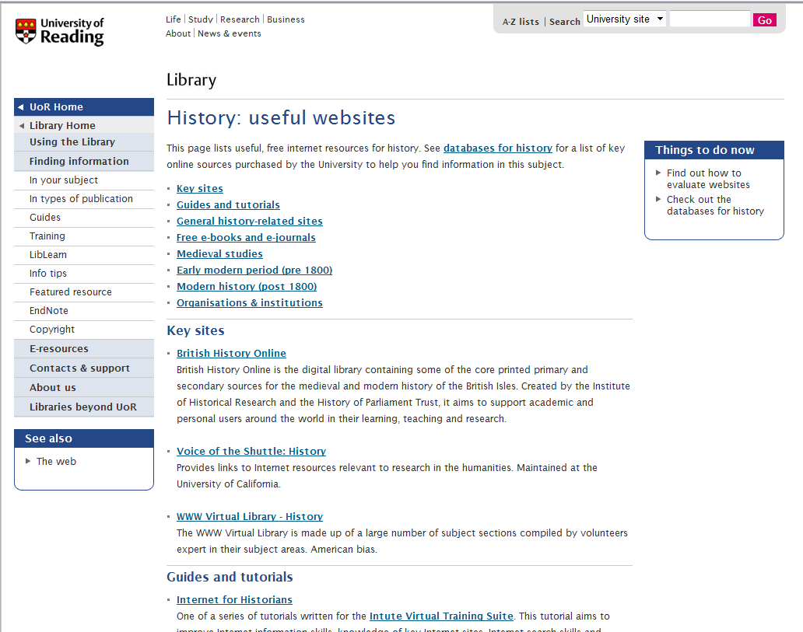

Slide 29
3
Resources outside UoR Library

Slide 30

Other electronic resources
University of Southampton's Extended Project Support guide
JISC collection for schools
Google Scholar and Google Books
Reading public library
Project Gutenberg
Directory of Open Access Journals
PubMed Central
Centaur – Reading University repository

Slide 31

Other electronic resources
Government websites (.gov.uk)
  E.g. The Department of Education
Society websites
  E.g. Royal Historical Society
Academics’ websites / blogs
  E.g. Dr Ben Goldacre Bad Science
Not for profit organizations (.org.uk)
  charities, trade unions, public arts organisations
  E.g. Oxfam

Slide 32
Further suggestions
Virtual Learning Environment (VLE)
  A useful place to put information for students
Experience sharing with other schools
Resources sharing with other schools

Slide 33
Summary
Preparing for a visit
  Information on the Library website
  Email me r.gooding@reading.ac.uk to arrange
Finding information
  Plan searches
  Use the catalogue
  Evaluate the information found
Other resources
  Online possibilities
  Other libraries
  Virtual Learning Environment

