Slide 1
Year 12 Induction Evening for students and parents
3rdOctober 2013

Slide 2
Welcome
The Sixth Form team
Head of Year 12 Alan Kydd
Deputy Head2 of Year 12 Mike Hanham/Jenny Fisher
Key Stage 5 Leader Gisella Vignal
Sixth Form Manager Chris Bullion
Sixth Form Administrator Sharon Bell
Head of Year 13 Richard Hand
Deputy Head of Year 13 Lucy Goodhew
SLT link for Year13 Steve Rayner

Slide 3
Aims of the evening
Information on structure and content of AS and A2 courses.
Information on the differences between life at Key Stage 4 and Key Stage 5.
An opportunity to meet the Sixth Form team.

Slide 4
Aims of the Sixth Form
To work with students and parents to ensure that our young people achieve, not only academically, but also develop the skills and attributes which are essential to success in later life.

Slide 5
Easing the transition to KS 5
Our expectations of students
Agreement
Hard work
Study skills
Time management
Effective use of study periods and home study

Slide 6
MORE FREEDOM
MORE RESPONSIBILITY

Slide 7
The Agreement: A Partnership
“I can expect to be treated as an adult”
“I will set target grades…equal to or higher than my minimum target grades”
“Appropriate behaviour, appearance and language”
100% attendance”
“Punctuality”

Slide 8
Support for Students
KS5 learning mentor guided support during study periods
Liaise with subject staff
Part of monitoring programme

Slide 9
Attendance
Attendance at lessons is not optional
Students’ attendance is checked weekly and dealt with by a series of increasingly serious sanctions.
Persistent offender s will find that their future in the Sixth Form will be under review.

Slide 10
Home Study and Study Sessions
Home study if no timetabled lesson
First lesson period 2 – go straight to lesson (morning Home Study)
Period 5 as Study – Weds/Fri, Home Study after last lesson 1.20
Or after tutorial/assembly 1.45 on Monday, Tuesday & Thursday
SIGNING IN AND OUT IS VITAL

Slide 11
Mentor Meetings
Bridge the gap between KS4 and university/career
Scheduled at mutually convenient times, perhaps before period 1, more often Wednesday or Friday at 2.05 when you have a lesson period 5.
“review progress, discuss future plans and any concerns”

Slide 12
Communicate
This is about cooperation not conflict
We are not the ‘enemy’
Talk to us – don’t be an ostrich!
A Levels and FE are challenging! If you can do it easily, you’re not learning!
Persevere!
It’s ‘cool’ to be clever now!

Slide 13
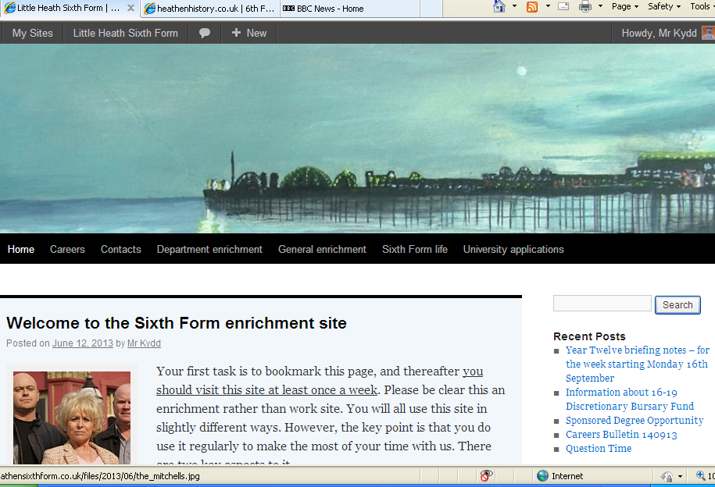

Slide 14
http://heathensixthform.co.uk/

Slide 15
Plan for the future
Prioritise commitments
Social life
Part time job
SCHOOL WORK
(16 hours per week outside school)
Sixth Form Centre open from 7.30am to 5.00pm

Slide 16
Be independent learners
Ask for help
Use PLCS and enrichment website
Reading and research

Slide 17
Personal Learning Checklists
Developed by departments in all subjects at AS
Student friendly checklist of knowledge and skills they will need to succeed in their subjects.
Available on enrichment website
Independent learning

Slide 18
The Curriculum
The Curriculum
Broad curriculum on offer
4 AS in Year 12
3 or 4 A levels in year 13
Opportunity to study a wide variety of courses.
Level 2 BTEC First Diploma in Health and Social Care
Opportunities to re-sit GCSE Mathematics and English

Slide 19
Assessment
Students study 2 or 3 units in each of their AS subjects.( Most A levels are made up of 4 units)
The marks achieved in these units contribute to half their final A Level grade.
An AS is a separate qualification but it’s also half of A level
BTEC assessment 6 units – mostly coursework
.

Slide 20
The Importance of Coursework
Some units are assessed by examinations others by coursework.
Deadline dates in tonight’s booklet.
Check Department handouts for further information.
DON’T GET BEHIND

Slide 21
Getting coursework right
Assessment objective of most KS5 subjects
Applied A levels - coursework accounts for two thirds of the final mark.
Essential to break up tasks and plan time effectively so that deadline is met and final product is the best piece of work a student can produce.
Deadlines in pack – look out for pinch points.

Slide 22
Examination Entries
Assessment seasons in June only
All individual units may be retaken – but not until June of year 13
Best results stand
Yr 12 June All AS units Whole AS
Yr 13 June All remaining A2 units + any re-sit unit
Whole A2

Slide 23
Target Setting - Aiming high
At the start of Year 12 all students are given minimum target grades for AS and A level based on how they did at GCSE
We ask students to think beyond these and set themselves target grades which include some challenge.
Planning and researching future career paths is integral to this process.

Slide 24
Why we discourage students dropping subjects at AS
Students with an average GCSE performance of C nationally
Number of AS subjects taken | 2 | 3 | 4
Number of students | 1391 | 3346 | 1111
Average grade per subject | DD | CCD | CCCC

Slide 25
A* at A Level
To be awarded an A*, candidates will need to achieve a grade A on the full A Level qualification and an A* on the total of the A2 units.
That means an overall score of 80% to gain grade A
Only those candidates who also score 90% on their A2 (Year 13 units) will gain A*

Slide 26
Year 12 Introduction Mentor Evening
Thursday 7th November Y12 Introductory recording sent home
Thursday 14th November – Mentor evening
Mentor, student and parents discuss:-
how their son/daughter has settled down to work at Key Stage 5
strategies to achieve these targets
Parents’ Evening with subject teachers on Thursday 13th February

Slide 27
Developing the whole student
Skills for future jobs and careers
Voluntary Service in the Community - a wide variety of options available
Sixth Form Committee
Tutor Reps
PHSE
Competitions

Slide 28
Discretionary Bursary Fund
Replacement for EMA
Information enclosed in letter - also available on website.
Guaranteed Bursary - £1200 per year.
Discretionary Bursary – Deadline for applications - 17th October .
Payment dependent on full attendance

Slide 29
The Way Forward
Importance of working together
Subject specific information available
Results Day Thursday 14th August

