Slide 1
David Dein
Little Heath School
19 October 2016

Slide 2
PL Formation VT

Slide 3
DAVID DEIN

Slide 4
THE VIRTUOUS CIRCLE IT STARTS AND ENDS WITH THE BEST FOOTBALL
BEST SHOW
CSR
MAXIMUM INTEREST
COMMERCIAL SUCCESS

Slide 5
A REVIEW OF SEASON 2015/16
1,026 GOALS SCORED
AVERAGE/GAME: 2.70
AVERAGE ATTENDANCE
36,481
96.3% STADIUM OCCUPANCY
50 HOME GROWN PLAYER DEBUTS
Notes:
GDS – finally. Views?
EPPP – ref World Cup/England team. Long term plans
Occupancy - our best measure – you all want to see and show full stadia
Introduction of the Away Supporters’ Initiative – Clubs’ commitment to invest in service to and facilities for their own travelling fans as well as visiting away fans
- Indications from the first season suggest it has arrested the decline in away attendance
Attendance – highest since 1949/50
Goals – there were some special ones for your viewers. And both Manchester City and Liverpool both scored in excess of 100 goals

Slide 6
PROGRESS 1992 - 2016
 | 1992/93 | 2015/16
AVERAGE ATTENDANCE | 21,125 | 36,481
STADIUM OCCUPANCY | 69.6% | 96.3%
International Broadcast Territories | - | 229
International Broadcast Contracts | 1 | 80+
TOTAL INCOME GENERATED | £40m | £1.975bn
LOWER LEAGUES & FOOTBALL DEVELOPMENT | £5m | £280m+

Slide 7
ATTENDANCES 1992/93 to 2015/16

Slide 8
AUDIENCE DEMOGRAPHIC
occupancy | 96.3%
women | 25%
ADULTS | Average age 41
18 to 34 | 40%
BME | 12%
Under 16 | 12% of season ticket holders
Away tickets | £30
Notes:
The Clubs work tirelessly to fill their stadia and most do so on a regular basis
Great to see more children, women and BME supporters and that has a lot to do with the more welcoming atmosphere the Clubs are creating

Slide 9
PREMIER LEAGUE CLUBS’ TURNOVER ANALYSIS 2007/08 to 2013/14 Actual and 2015/16 Projected (€m)
Source: Deloitte

Slide 10
PL FOUNDER MEMBERS AGREEMENT
HOW REVENUE IS DIVIDED
(Formula unchanged since 1992)
UK TELEVISION
INTERNATIONAL TELEVISION
OTHER COMMERCIAL
50% Equal Share
to each Club
Equal Share
to each Club
Equal Share
to each Club
25% TV APPEARANCES
BOTTOM CLUB 65% PAYMENT TOP CLUB
25% FINAL POSITION

Slide 11
FINANCIAL STABILITY FOR CLUBS 2013/14 – 2015/16
Losses capped across three seasons at
≤ £105m

Slide 12
FINANCIAL STABILITY FOR CLUBS
Level of increased Premier League central funds available for Clubs to use on player wage costs
Controls apply above a player wage cost floor
£4m
£8m
£12m
£52m
£56m
£60m
2013/14
2014/15
2015/16
2013/14
2014/15
2015/16

Slide 13
UK BROADCAST PARTNERS
126 matches - live TV
(1230hrs Sat, 1330hrs Sun, 1400hrs Sun,
2000hrs Mon)
42 matches - live TV
(1730hrs Sat, 2000hrs Midweek and Bank Holiday matches)
380 matches TV highlights
380 matches
380 matches
internet and mobile clips
128 matches live radio
64 matches live radio
Notes:
Welcome back to our existing partners
Absolute Radio
BBC Sport
BBC Radio 5 Live
Sky Sports
talkSPORT
A big hello to:
BT Sport
News UK
You are all very welcome and we look forward to working with you all

Slide 14
GLOBAL AUDIENCE 1.2 BILLION LIVE VIEWERS VIA 80+ BROADCASTERS
NORTH AMERICA
& CARIBBEAN
140m 3.7M
UK
184m 5.76M
EUROPE
454m 12M
CHINA
42m
MIDDLE EAST &
NORTH AFRICA
77m 2M
ASIA & OCEANIA
(EXCL CHINA)
346m 9.1M
SOUTH &
CENTRAL AMERICA
61m 1.6M
SUB-SAHARAN
AFRICA
82m 2.2M
CUMULATIVE AUDIENCE / WEEKLY AUDIENCE

Slide 15
DEVELOPING HOME GROWN PLAYERS
Notes:
New Youth System
System has been in place for one season
- Club and stakeholder buy-in
- Belief in quality, evidence-based agenda
- Foundations now laid for long term vision and success
40 Premier League and Football League Clubs categorised
Enhanced Club education provision in place

Slide 16
Manchester City’s new training ground

Slide 17
Tottenham Hotspur’s new training ground

Slide 18
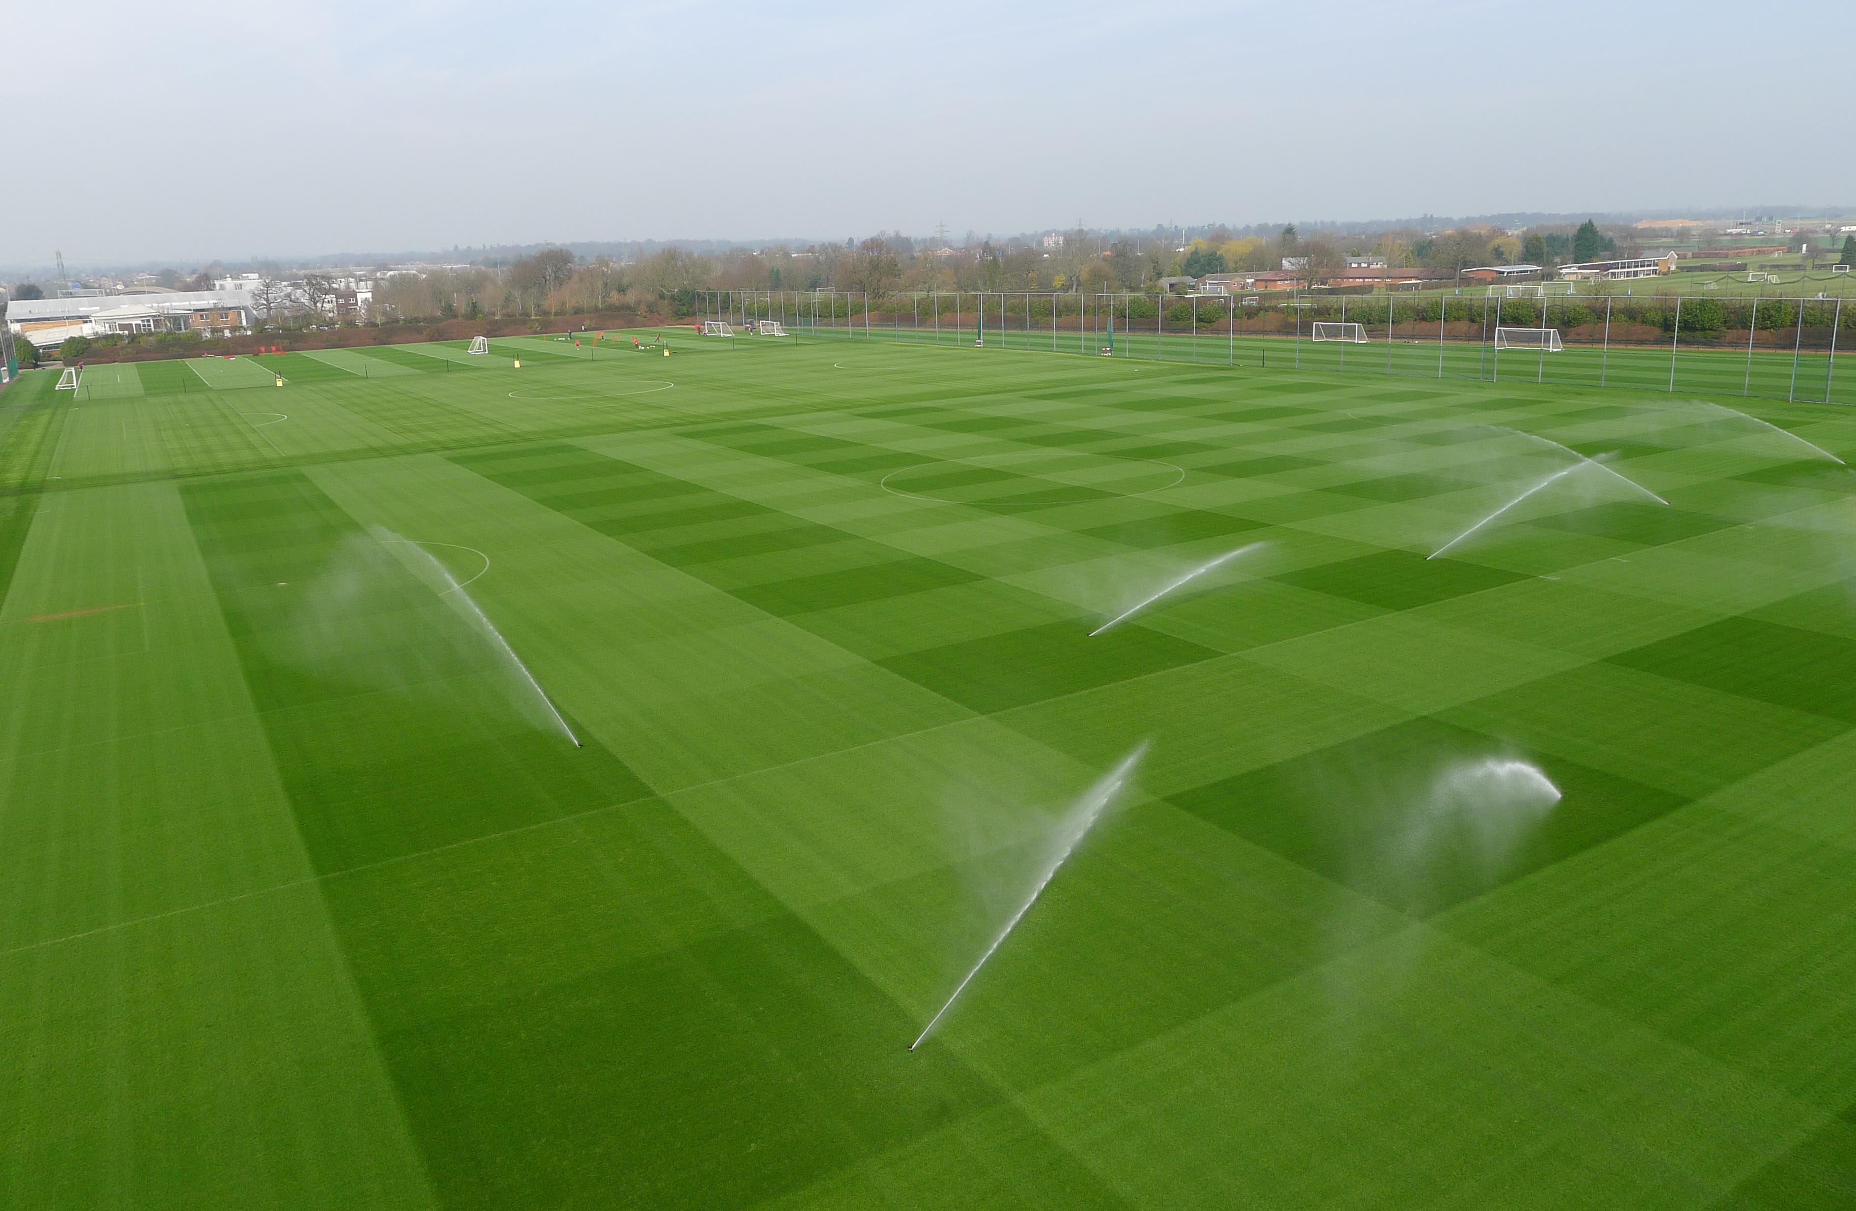
Arsenal’s training ground

Slide 19
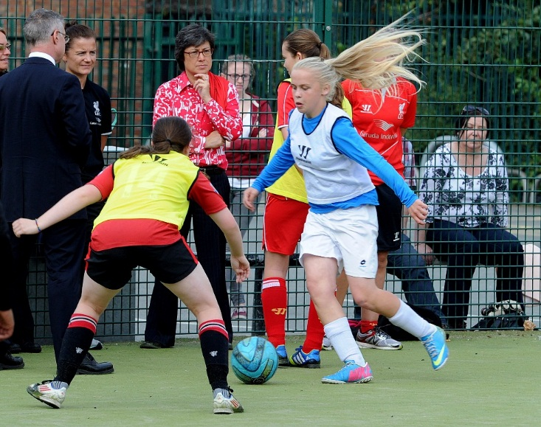
Women’s and girls’ football
Growth of the game
Fastest growing sport in the country
Over one million women and girls now play football
Women’s Super League:
started with 8 teams in 2011
19 teams in 2016

Slide 20
Women’s and girls’ football
New Premier League Girls’ Football programme - over 20,000 participants in the first year
Notes:
ECAS - Premier League has agreed to fund six additional places on the Premier League Elite Coach Apprenticeship Scheme (ECAS) course each year which will be reserved for three BAME coaches and three female coaches. The Premier League will convene an advisory group, including former players and current/former club managers to help guide this process.
ECAS is a coaching project set up in 2013 as part of the Elite Player Performance Plan. Each Club with a Category 1 Academy can nominate one coach per year to be part of the two-year course. Each ECAS coach is provided with Premier League and external mentors and the opportunity to spend time at world-leading elite development environments.

Slide 21
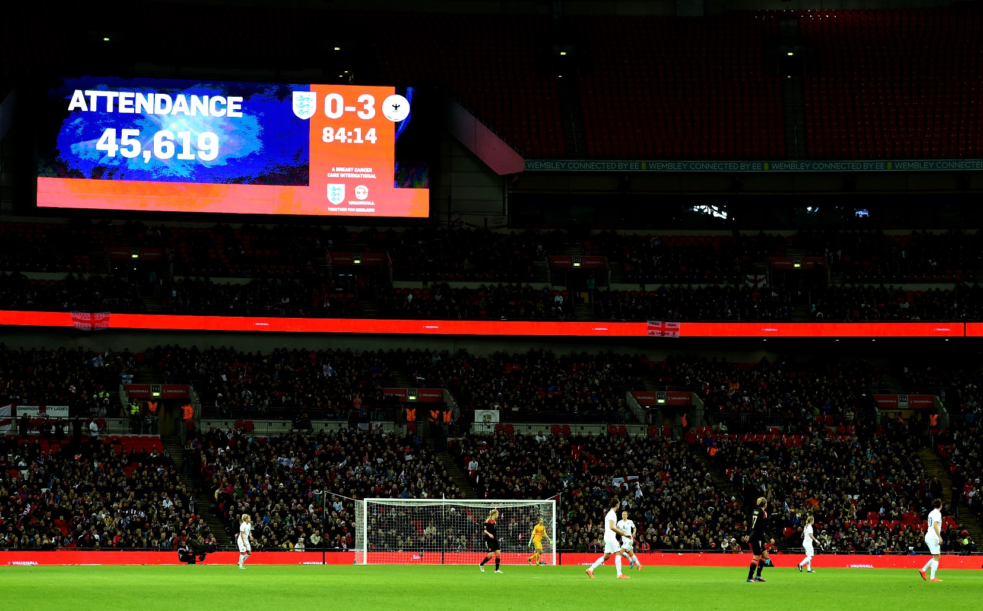
Women’s and girls’ football
More than 45,000 at Wembley for England v Germany
23rd November 2014

Slide 22
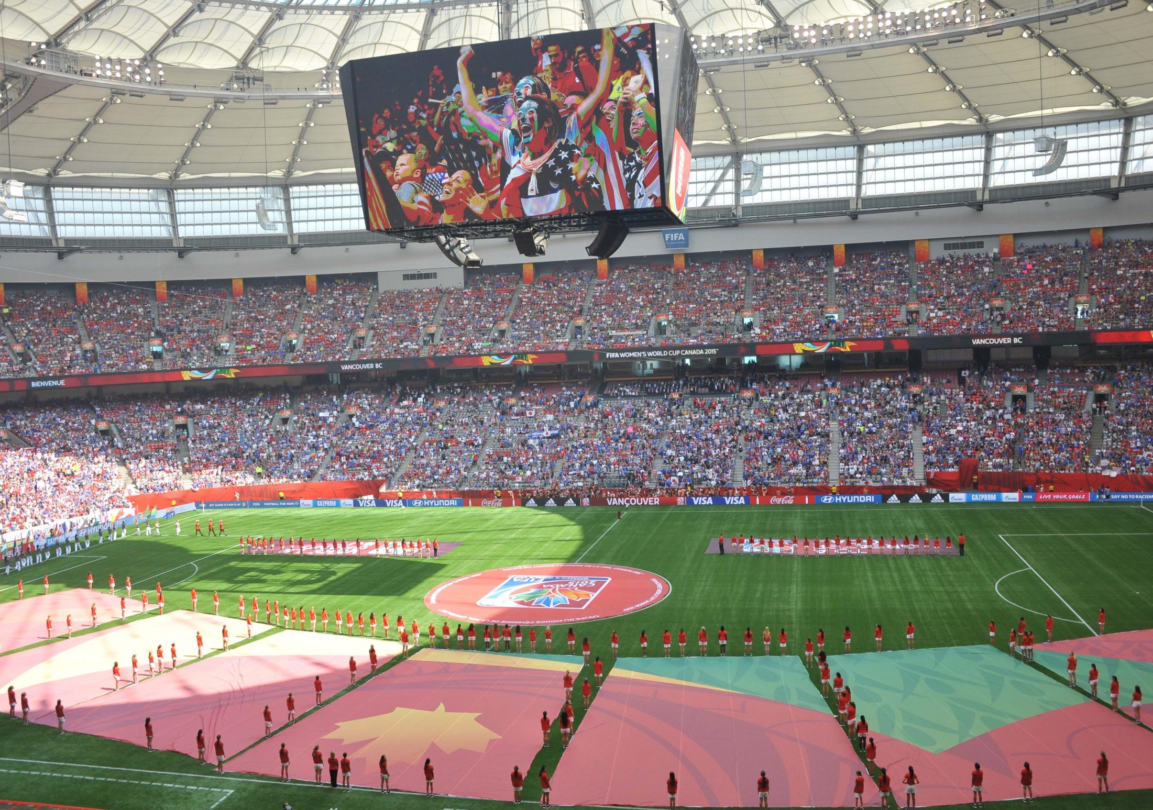
F
FIFA WOMEN’S WORLD CUP 2015

Slide 24
MOTIVATING MILLIONAIRES
PRIDE
REPUTATION
FINANCIAL INCENTIVES
MEDAL HAUL

Slide 25
WHAT MAKES A MODERN MANAGER?
SUCCESS IS A MUST
TIME PRESSURES
BUYING WISELY
INTRUSIONS
MONEY MATTERS
STYLE OF PLAY
DEALING WITH AGENTS

Slide 26
Technology

Slide 27
WHAT DO THESE SPORTS HAVE IN COMMON?
BOXING
BASKETBALL
ICE HOCKEY
RUGBY
INDEPENDENT TIME KEEPING

Slide 29
“It is a flaw in the game that referees are still responsible for timekeeping.”
Sir Alex Ferguson, September 2012

Slide 31
“I know a lot of referees would be quite happy to have timekeeping taken over by an official in the stand”
Graham Poll, former Premier League referee

Slide 32
‘Never judge or criticise a man until you have walked in his moccasins for two weeks’
Old Sioux Indian quote
32

Slide 33
Technology

Slide 34
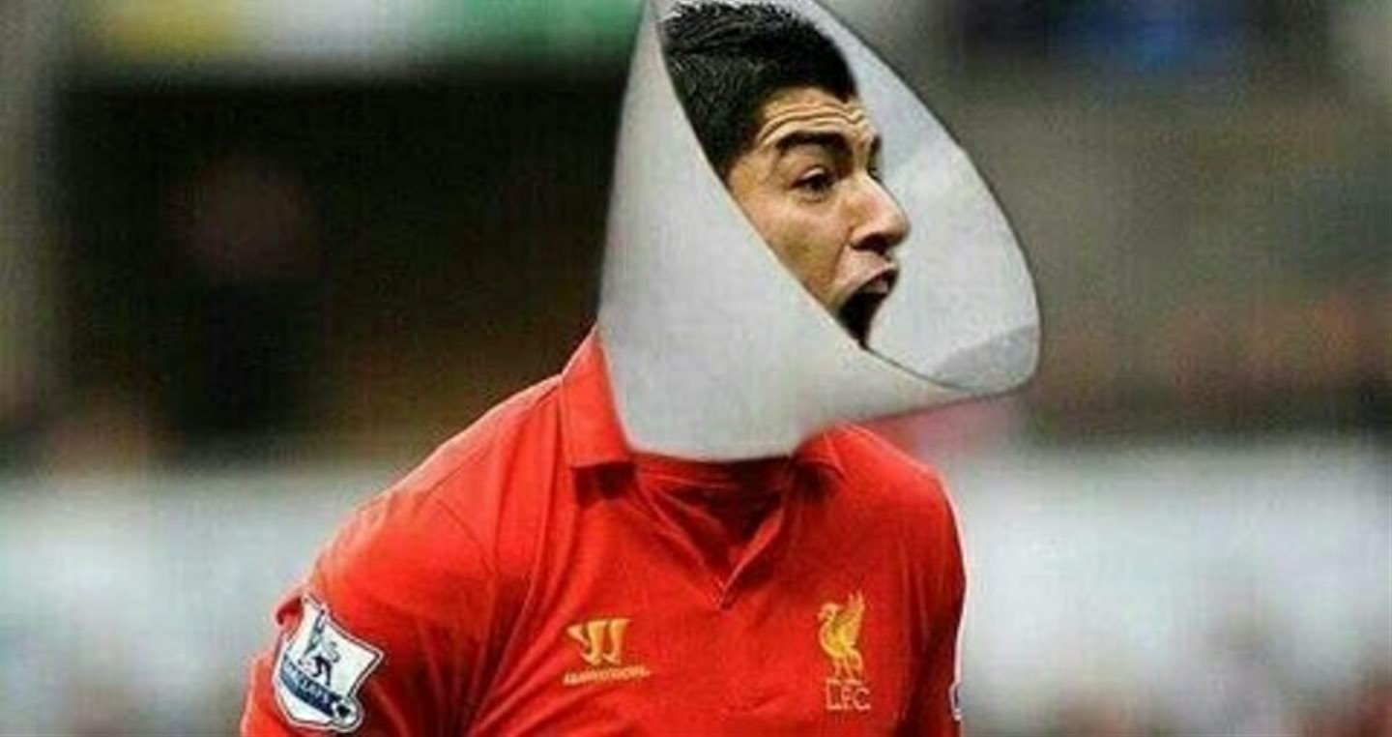
34

Slide 35
Goal Line Technology

Slide 37
DAVID DEIN

Slide 38
“Life isn’t about waiting for the storm to pass …. it’s about learning to dance in the rain”

Slide 39
“Nobody can go back and start a new beginning, but anyone can start today and make a new ending”

Slide 40
The Motto of the Turtle

Slide 41
DAVID DEIN

